Slide 1

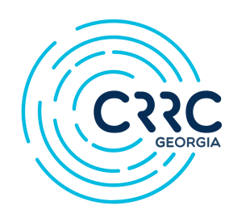


Works-in-Progress – 10th Anniversary Series – Spring 2020
March 18 – Hans Gutbrod, Iliauni and Transparify.org – “Translating Polling Data into a Political Vision”*
March 25 – Mariat Imaeva, Dublin City University – “Deferring Criminal Accountability: Humanitarian resolution of conflict-related disappearances in the Caucasus
April 1 – Levan Kakhishvili, Otto-Friedrich University Bamberg – “Is Georgian Party Competition Programmatic? Evidence from Party Manifestos”
April 8 – Alexandru Moise, CRRC Georgia and Iliauni – “Clientelism and Partisanship Shaping Healthcare Attitudes in EU Countries”
* 10th Anniversary Talk

Slide 2

Online Markets for Illicit Drugs in Georgia
A supply side analysis of the Matanga platform
Ian Goodrich, CRRC Georgia
Notes:
Good afternoon everyone, my name is Ian, I’m a Policy Analyst here at CRRC, and today I’m going to talk about drug use in Georgia.
I’m going to begin by giving a little bit of background on Georgia’s recent history with drugs, I’ll then take a look at how the drugs that are being used and the way they are bought are changing.
After that, I’ll introduce my research, which attempts to learn more about drug use in Georgia through a study of an online marketplace for trade in illicit substances, before presenting my findings.
We’ll see that drug markets in Georgia in 2020 are diverse and colourful places. We’ll cover a number of substances and concepts that will undoubtedly be new to many of you. I really don’t mind being interrupted if anyone needs clarification on anything, but please keep broader questions to the end.
This is, as the title of the series suggests, a work in progress: data collection was only completed last week, and a lot of what I’ll present today is descriptive and exploratory. I’m very much keen to hear feedback and new perspective on what I’m doing, and to have any errors corrected before I can commit them to paper.
Are we sitting comfortably? Then I’ll begin.
I want to begin today’s presentation with a statistic. When I first came across it, I found it a little shocking.

Slide 3
Georgia has the second highest per-capita rate of adult injecting drug use in the world
Notes:
Georgia has the second highest per-capita rate of adult injecting drug use in the world. Around 2.2 percent of adults, or about 52,000 people are estimated to have injected drugs in the last month.
These are 2016-17 figures, cited in the 2019 World Drugs Report by the UN Office on Drugs and Crime, and are drawn from a sophisticated survey-based population size estimate by the Curatio Foundation and Bemoni public union.
Looking at the last three waves of this study, there is also some evidence that the population may be growing.
This is not a problem that’s unique to Georgia alone. Neighboring Azerbaijan has approximately 70,000 injecting drug users, and Russia in excess of 1 million.
Per-capita figures are tricky, of course. The largest per-capita rate is in the Seychelles, which has a total population roughly equal to Georgia’s estimated injecting adult population.
Regardless of the vagaries of per-capita statistics, Georgia undoubtedly has a very serious problem. Historically, some of the most frequently abused substances have been opiates, notably Subutex. We often hear the words “opiate crisis” or “opiate epidemic” used in the context of the United States, but the more I read the more its clear that Georgia has been battling its own opioid crisis for the last 20 years.
The government, have responded in two key ways: through punitive enforcement measures, which began under the UNM, which have seen lengthy jail terms for possession of minute quantities of almost all narcotic substances.
There is also a national treatment program for those with addiction problems, with both abstinence and opiate substation approaches used. In 2017, these treatment programmes served over 10,000 individuals.
I began here because this is such a big issue and I really don’t think it’s possible to talk about drugs in Georgia without covering injecting drug use and opiates.
That said, whilst injecting drug use is a particularly problematic form of drug use, it is not the only form of drug use, and opiates are not the only form of drug.

Slide 4
New Drugs
Notes:
There’s increasing evidence that new categories of substances are being used widely and that changing patterns of use are opening up users to new risks.
I’m now going to discuss a couple of high-profile incidents of drug harm in Georgia, and look at what they tell use about the evolving risks associated with drug use.
I’m then going to briefly discuss a new category of drugs, before moving on to changes in how drugs are bought and sold.

Slide 5

New Drugs
May 2018: five young people die at Bassiani
Understood to have taken fentanyl
Believed they were taking mephedrone
August 2018: Anaklia Echowaves festival
One dead, three hospitalized after taking an unknown substance
Notes:
The summer of 2018 saw two separate and high-profile drug-death incidents. Firstly, in a case that lead to a major police raid of the Bassiani nightclub, after mistakenly taking what is now thought to have been the powerful synthetic opioid, fentanyl. The clubbers are believed to have thought they were taking the stimulant, mephedrone.
In a separate incident, one festival-goer died and three were hospitalized after taking an unknown substance at the Echowaves festival in Anaklia.
These two cases are important for a number of reasons:
Firstly, they show changing patterns of drug use: these incidents occurred at large-scale public gatherings.
The opioids discussed in the previous slide are far less prevalent in club and festival scenes, where other substances such as MDMA, cocaine and less frequently LSD and Ketamine are often preferred.
These cases highlight a new and potentially growing drug using population, with different substance preferences and risk profiles.
Secondly, it highlights the problem of accidental overdose: Drug users taking substances in a club or festival setting often do so with poor information about the substance they are taking, putting them at risk of taking too much of a substance, or taking an unintended substance – as was likely the case in both the incidents I just described.
Thirdly, these cases are important, as we know about them primarily through the media. We actually have very poor information on drug deaths and hospitalizations through health records. Drug deaths are rarely recorded as such, and the substance involved is almost never on public record.
We know about these cases because they’re famous, but we don’t have the information available to know how common they are.
Finally, one of the substances involved is particularly interesting. Has anyone hear heard of mephedrone, with an R, not to be confused with methadone? It’s something that is often referred to as a New (or sometimes Novel) Psychoactive Substance – it’s a category of drug I think requires a little more explanation before I dig into my findings.

Slide 6
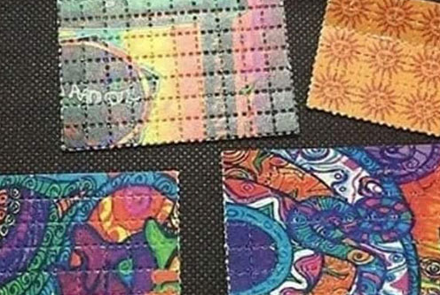
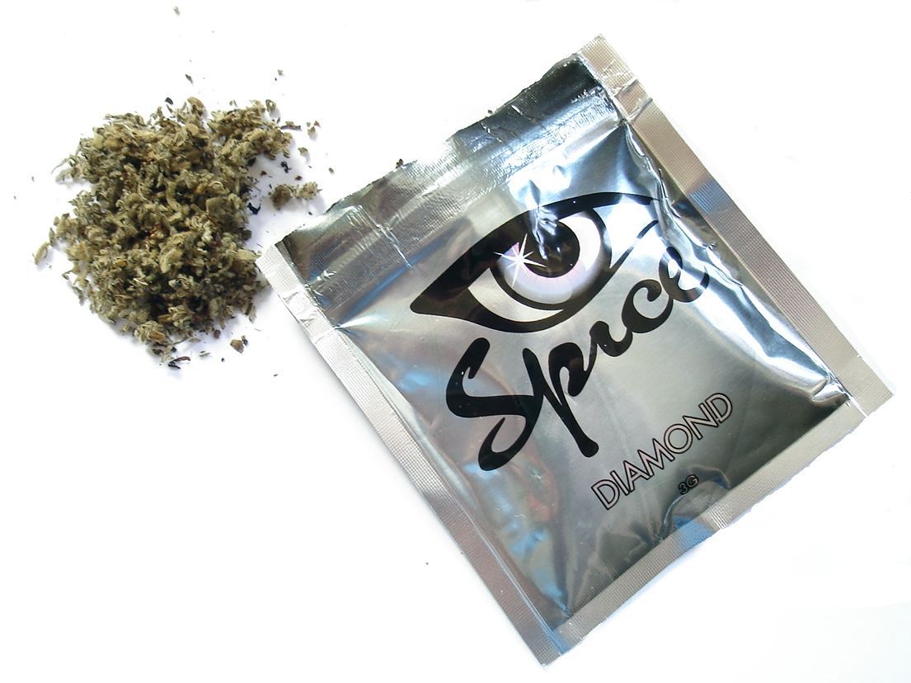
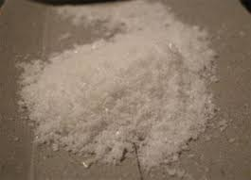
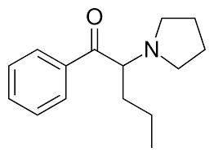

New Psychoactive Substances (NPS)
Term originated in mid 2000s
Originally describing psychoactive substances that were not illegal
EC Council Decision 2005/387/JHA
‘Narcotic or psychotropic drugs that are not scheduled under [international] Conventions, but which may pose a threat to public health comparable to scheduled substances
Most are now illegal, including in Georgia (2018)
The term is typically applied to “non-classical” drugs
Notes:
The term “New Psychoactive Substance” or NPS is a phrase you’ll see a lot in the drug policy literature. It originates in the early to mid 2000s when a large range of substances which were not then illegal began to be sold openly in European and American markets.
I remember this happening. Local corner shops in the UK were selling products marketed as “Legal weed” or “Legal ecstasy”.
There are many hundreds of substances described as NPS. We just touched on Methadrone – a stimulant with very similar effects to MDMA, but the most famous of which is probably “spice” – a blanket term for many varieties of synthetic cannabis. The “legal weed” I mentioned just now.
Just as many of these substances were initially marketed as legal alternatives for other substances, now many of them are illegal, they are sometimes used as substitutes when more desirable substances are unavailable.
In Georgia, the term “bio” is often used as a prefix to describe NPS: bio-marijuana, for example refers to synthetic cannabis, bio-LSD, for example is used to describe 25i-NBOMe, pictured top left. I think.
I say “I think”, as that’s just a picture I pulled down from the internet – I guess it’s 25i-NBOMe, because Google told me – here’s some LSD in blotter form for reference. I think.
Many of these products are visually very similar to other well-known drugs. In the case I just mentioned, a user would only know the difference after putting it in their mouth. If someone is smoking or snorting a substance, injecting it or swallowing it whole, they wouldn’t know they’ve taken something unintended until the effects kick in.
Many of these substances are also significantly more dangerous than the product they resemble. 25i-NBOMe can be lethal in relatively small doses, too much LSD can cause a number of problems, but death by poisoning is not one of them.
Similarly, synthetic cannabis, can be addictive, cause seizures, and induce catatonia or psychotic episodes.
So we have this new, large and colourful category of substances. We know very little about many of them, because they have a limited history of use. Many of them resemble other drugs, and are often significantly more harmful.
Many of them are being sold in Georgia today.
I’ll get into the detail shortly, but before I can introduce my research, I need to quickly cover another changing dynamic in Georgian drug markets.

Slide 7
New Markets
Notes:
Just as new drugs are appearing in Georgia, drugs are also being bought and sold in new ways. My research attempts to take advantage of some of the new developments in drug markets to find out more about how people are using drugs.

Slide 8
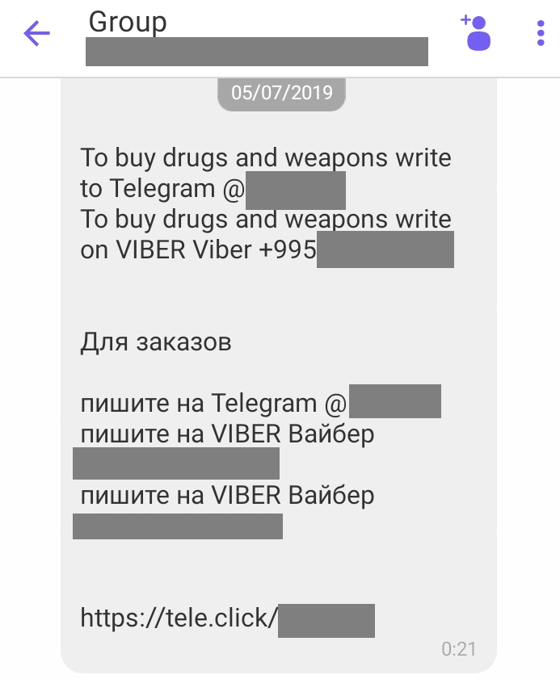


New Markets: Messaging Platforms
Encrypted messaging applications allow secure communication between purchaser and seller
Platforms also used for advertising:
Chat groups
Spam
Buyer-seller communication
Notes:
In July last year, somebody with a Romanian number added me to a Viber group with hundreds of other users offering to sell me drugs and weapons. Has this happened to anyone here, by the way?
I must have given my number to a seriously dodgy taxi driver sometime/I’m glad I’m not alone.
The message itself was in Russian with a little English, and absolutely no Georgian, except in all the responses – which were largely along the lines of “Giorgi is that you?” and “How did you get this number?”.
Encrypted platforms such as Telegram and Viber provide a channel for secure communication between drug sellers and drug purchasers, and in the case of my spam message – between drug sellers and the general public.
Their use twofold: in marketing, either through groups that people join to find drugs – such as the one I was invited to in that message, or for safe, one-to-one communication between sellers and buyers.
Other drug policy researchers I’ve spoken to have told me that these sorts of messaging platforms are the main mechanism through which young Georgians are purchasing drugs.
These groups contain an untapped wealth of information about drug use patterns, but accessing this information systematically is technically very challenging.
I’m looking at something else.

Slide 9

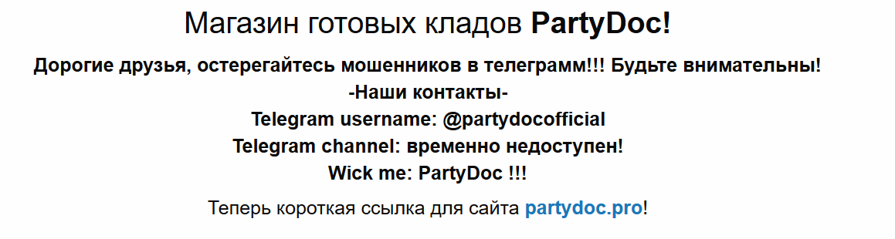
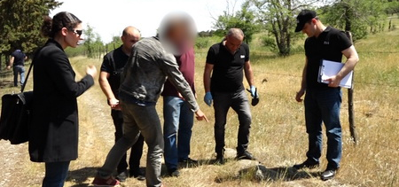

New Markets: Online Shopping
Online cryptomarkets functioning in Georgia
Payment by bitcoin
Delivery by drop-off in hidden locations
Single-vendor/multi-vendor
Source: Agenda.ge
Notes:
Just as its now possible to order takeaway and taxis online, it’s also possible to buy drugs using the internet. This isn’t a particularly new phenomenon, in fact, the first recorded internet drug transaction has been traced back to the seventies – a small-scale weed deal at a university in America.
Since the early 2010s, large e-commerce sites have sprung up for the drug trade. Some of you might have heard of the Silk Road? The Silk Road was an online marketplace that was functioning world-wide between 2011 and its closure by the FBI in 2013. Similar websites continue to thrive to this day, and they also appear to be used in Georgia.
They are in form very similar to any online shopping site you may have visited, such as Amazon or Ebay. They contain listings from one or more vendors, offering a variety of different substances. Transactions are typically made through bitcoin, although some sites support other cryptocurrencies – this enables the transaction to be relatively anonymous.
Many, but not all, of these sites are only accessible through the Tor network. The combination of bitcoin and Tor means both buyer and seller can be reasonably confident that they won’t be identified by law enforcement through their online activity.
Western markets have traditionally used the postal system for order fulfillment, but in this context the Georgian post is probably not a good way to ensure quick and secure movement of goods.
The sites I’ve looked at both operate on a dead-drop system, where items are hidden and collected using a GPS code after payment.
In the bottom left there, we have a picture of a suspect and law enforcement retrieving hidden drugs somewhere in Tbilisi.
On the right, we see two such markets: Party-doc, a single-vendor site, and Matanga, a marketplace where multiple vendors operate. My research focuses on the latter.

Slide 10
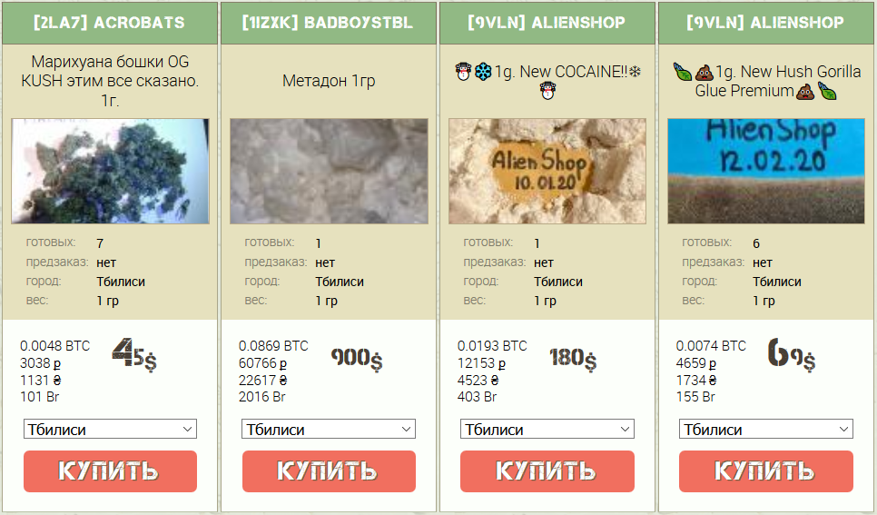
New Markets: Matanga
FSU focus,
Established 2014
Blocked in Georgia but accessible via VPN or Tor
Languages:
Russian
English
Locations:
Tbilisi
Batumi
Kutaisi
Notes:
I’ve looked in detail at Matanga, a large website which covers numerous states in the Former Soviet Union, with a particular emphasis on Russia. It is technically accessible without Tor, but has been blocked in Georgia – requiring a VPN or Tor to access.
According to its website, it has been active since 2014, although I’m not clear on how long it’s been operating in Georgia. The first record of it I can find is in an MIA press releases from March 2018. [https://agenda.ge/en/news/2018/717, March 30, 2018: Police detains drug dealer who imported large amount of drugs via emergency car]
Listings are in Russian and English. Prices are always given in bitcoin but the other currencies use vary from listing to listing. I’m yet to see a listing in the Georgian language, or a price given in Lari.
It offers a very wide variety of substances for sale at locations in Tbilisi, Batumi and Kutaisi. There is also a section of the website for Anaklia, which has hosted a number of festivals in recent years. I’ve been looking at it off-season, and I’m yet to see a listing for Anaklia.

Slide 11
Methodology
Notes:
So, what am I doing with this website?

Slide 12
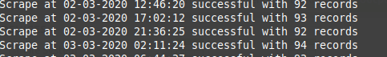
Scraping and Sales Estimation
Web-scraping:
Python
Selenium
Tor Browser
February 5 – March 5, 2020 inclusive
Minimum 4 scrapes per day of all Georgia records
After cleaning:
19,733 observations
406 substance listings
72 unique vendors
Sales estimation:
Changes in the number of packages listed as ready for collection
Likely misses larger transactions
Aldridge, and Décary-Hétu. "Not an'Ebay for Drugs': the Cryptomarket 'Silk Road’ as a paradigm shifting criminal innovation." (2014).
Notes:
I’ve been undertaking an ongoing web-scrape of the Matanga platform. I started playing around with it in November last year, but due to other priorities and a few technical hitches, I’ve only recently completed a full one month scrape, which covers most of February and early March 2020.
For those of you who haven’t encountered webscraping before, it’s a process for systematically converting html into machine-readable data. Going from [flick back] to a tabular structure – like an Excel sheet. This approach has been used by many other researchers in the past, I’ve taken particular inspiration from Aldridge and Decary Hetu, but as far as I’m aware this is the first time something like this has been done that focuses on Georgia.
After cleaning, I get around 20,000 records, which are repeat observations of around 400 unique listings, from 72 vendors.
One of the nice things I can do with this data is make an estimation of how many sales are made from each listing. At one point, I had a whole slide on sales estimation, it’s a bit complex, and I’m happy to talk through the details with anyone who’s interested after the talk. Essentially what I do is look for changes in the number of packages listed as ready for collection and control for restocking.
The problem with this approach is that larger listings are almost never listed as ready for collection. This makes sense, as it’s probably a very bad move to leave a large quantity of drugs hidden somewhere on the chance that someone might want to buy it.
So any sales figures I give are likely to be an underestimation. When I look at substances in detail, we can see where larger packages have been listed, but it’s pretty difficult to see where they’ve been sold.

Slide 13
Limitations and Advantages
Limitations
Advantages
Likely underestimation
Not representative, limited external validity
Not in Georgian
Western markets: male, 18-35, university educated
Geographical scope
Limited time period
Precise, clear, time-series picture of a drugs market
Realtime monitoring
Sales, quantity and value estimation, albeit for a subset of the overall market
Notes:
What I’m doing has a number of strengths and weaknesses.
As I just mentioned, this is likely an underestimation, most seriously as I don’t think I’m picking up the larger transactions.
I have absolutely no reason to believe this is in any way representative of the Georgian drugs market as a whole, for starters, the site isn’t even in Georgian. There’s also a degree of technical sophistication required to be able to conduct business in bitcoin, and evidence from western markets that typical users of these forums tend to be young, male and university educated.
On this note, as we’ll see soon, this site essentially serves Tbilisi, with some activity in Batumi. There are no listings for other cities. Again, limited external validity applies.
We’re also looking at a very limited time period: February-March isn’t peak time in most business. We see a lot of activity, but I may have found more if I was looking in peak summer, for example.
The nice things about this approach is that we get a really granular picture of a market in real time.
We get to do things like estimate sales, including how much has been sold and for what price.

Slide 14
Findings
Notes:
My apologies for the long preamble, but there are a number of background issues and technicalities I thought it important to explain.
On to the main event.

Slide 15
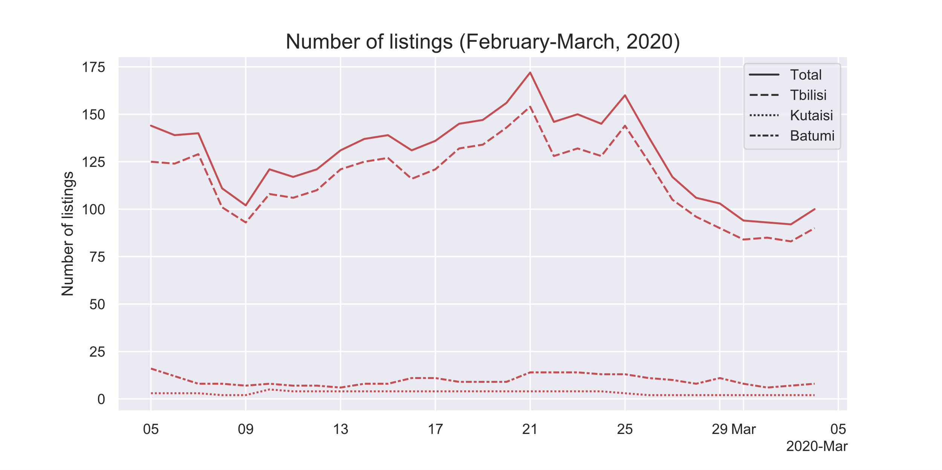
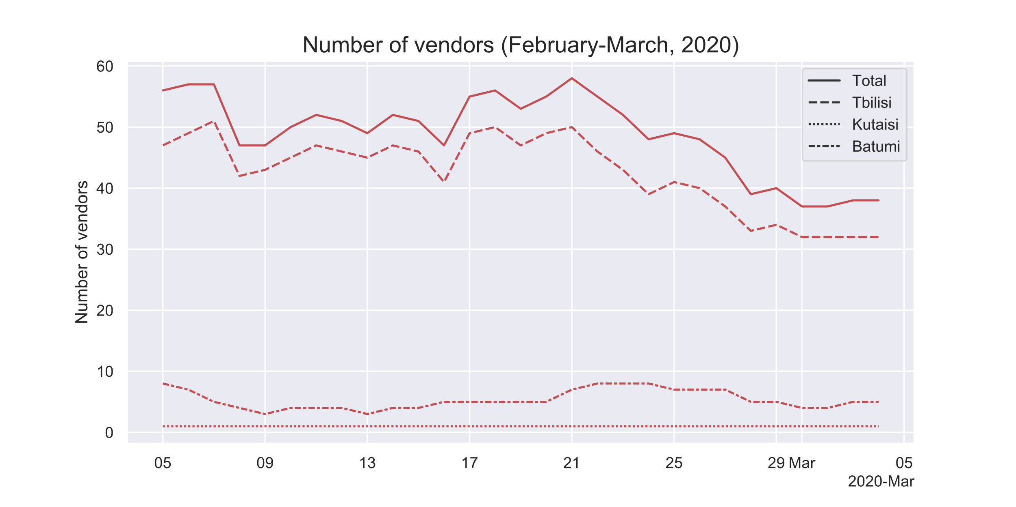
Listings and vendors per region
Listings
Vendors
 | Unique | min | mean | max
Number of listings | 406 | 92 | 128 | 172
Number of vendors | 72 | 37 | 48 | 58
Activity is centered on Tbilisi
Batumi much more active than Kutaisi, only one vendor in Kutaisi for most of the dataset
Notes:
So here we have a look at how many listings and how many vendors we have at any given time. We can see little peaks and troughs of activity, and a fall-off in late February, which I’ll look at more closely in the next slide.
All in all, we see that the market is pretty active and dynamic in Tbilisi and fairly quiet elsewhere. There’s only one vendor in Kutaisi for most of the data I’ve looked at. They call themselves Parnavaz, and they do a small, steady trade in weed.
Bear in mind then, that when I report my findings, I’m going to report on the country as a whole, but most of the activity is really in Tbilisi.

Slide 16
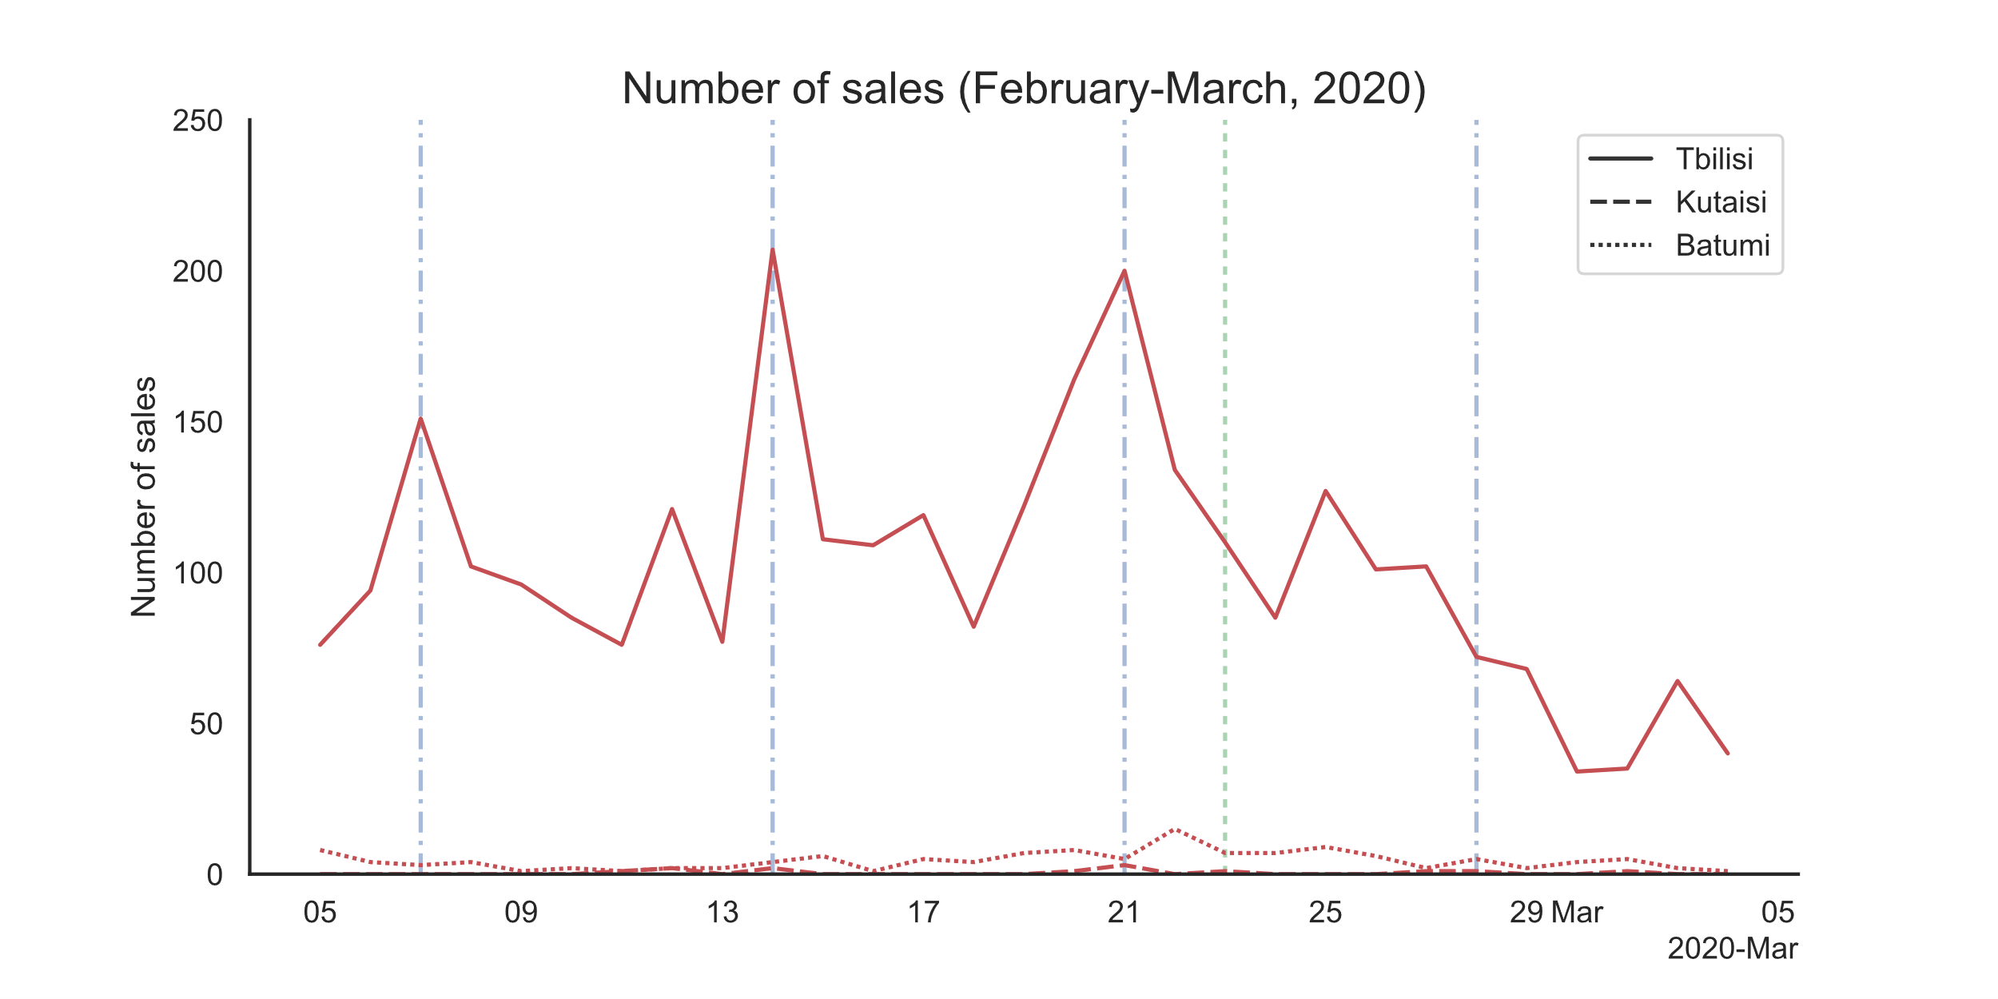
Sales over time
Sales
Notes:
Here we look at all the sales over time. I think this is probably my favourite chart of the lot. It shows the number of individual sales – that is transactions, we’re not looking at quantity sold or value yet – over time.
I’ve marked Fridays on the chart, and you can see the corresponding peaks in sales for the first three Fridays of the month.
Whilst finding that people enjoy drugs at the weekend is unlikely to win me any Nobel prizes anytime soon, it’s fascinating to see how pronounced the peaks are. I also like the little mini uptick every Wednesday.
We can also see a baseline level of activity that continues throughout, at least until the last week of February.
My working hypothesis is that we’ve seen an impact of the Coronavirus on the Georgian drugs market! This other dotted line I’ve marked is the 23rd of February, which is when I think people started getting a little more worried about the virus. It was the first day that I could find a record mentioning it on agenda.ge.
You can see how it completely kills the usual Friday spike, and that the baseline level falls dramatically afterwards.
The really interesting question here is whether this is a supply or demand-side dip. Are people buying less drugs because they’re going out less because of the virus, or are vendors selling less drugs because of tighter restrictions at borders?
A great question. There are ways to look at it, but I’ve honestly not had time. Expect a blog on this at some point.

Slide 17
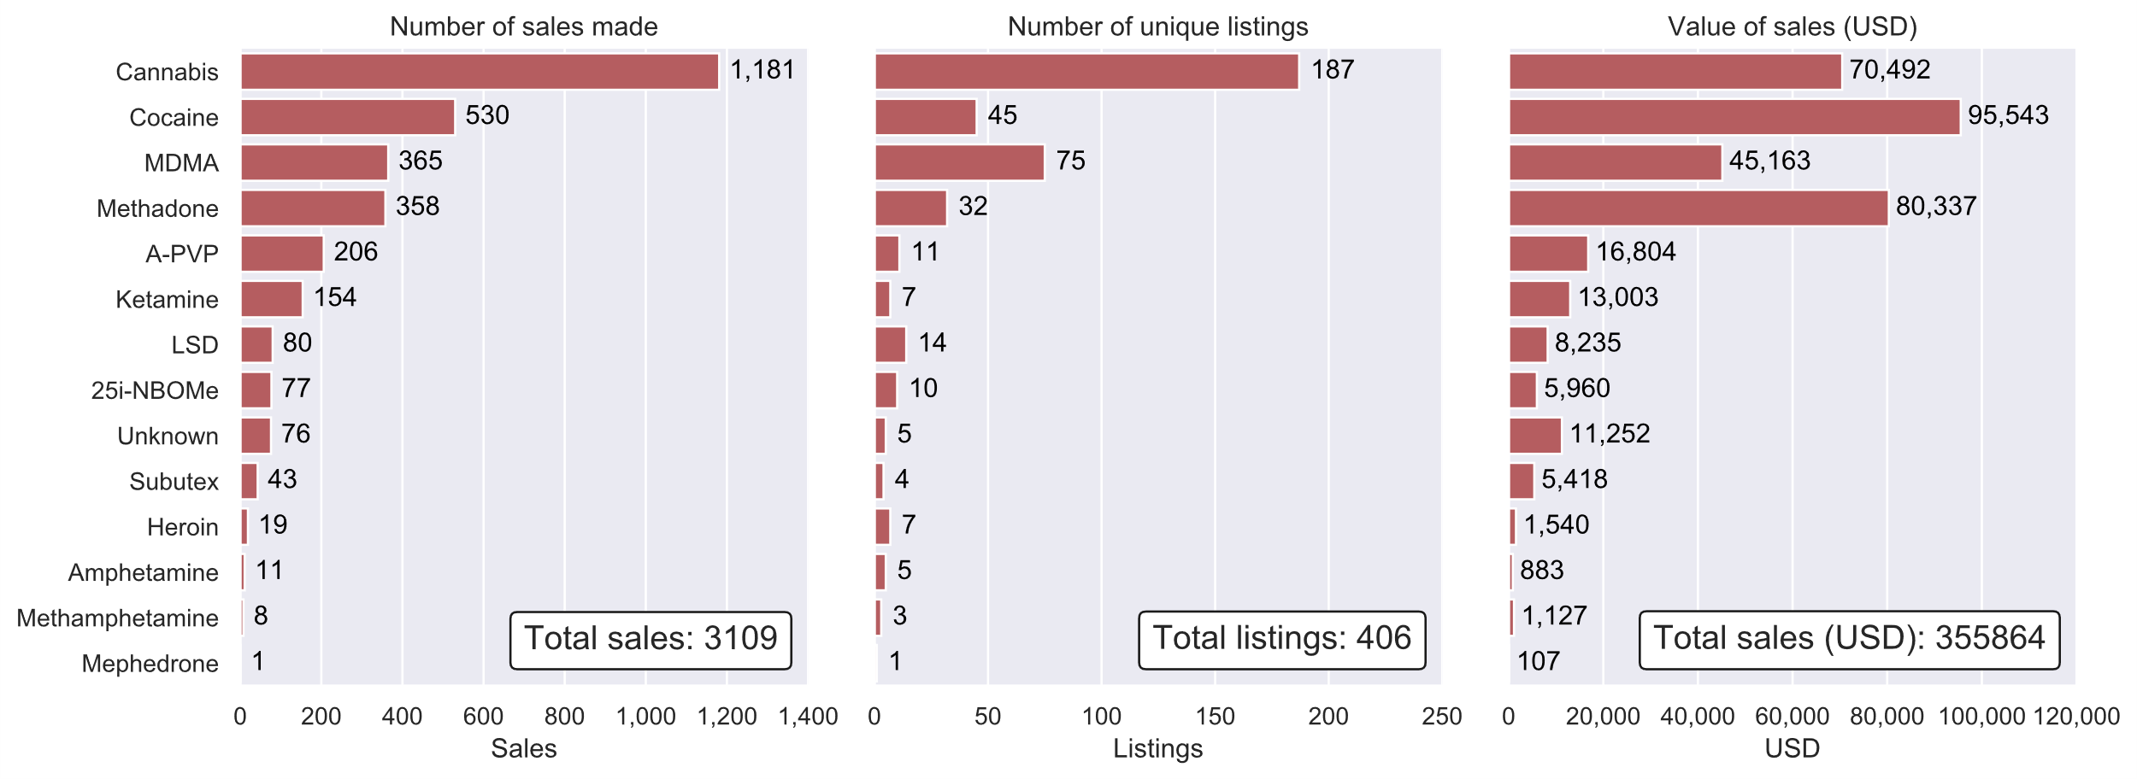
Substances
Substance listings and sales
Notes:
Total sales, listings, usd
Getting into per substance findings, We can see over 13 unique substances here, including a couple that I had trouble identifying.
Generally, we see a lot of the more famous household name drugs, as well as a number of New Psychoactive Substances, including Alpha-PVP, 25i-NBOMe and my mystery unknown substances.
I’m going to spend the rest of the presentation walking you through some of the major substances one-by-one. I’m prioritizing what I’m looking at by the number of sales made as prices varies a lot between substances.
We see that there’s a lot of cannabis, this is very much consistent with survey and seizure data I’ve seen, and probably not too surprising to anyone.
We also see an awful lot of cocaine sales, which has generated a lot of revenue for someone.
We also see large numbers of sales for MDMA, methadone, and Alpha PVP.
These are our top five, we can come back and look at this slide at the end if anyone wants a closer look at any of the smaller substances.

Slide 18
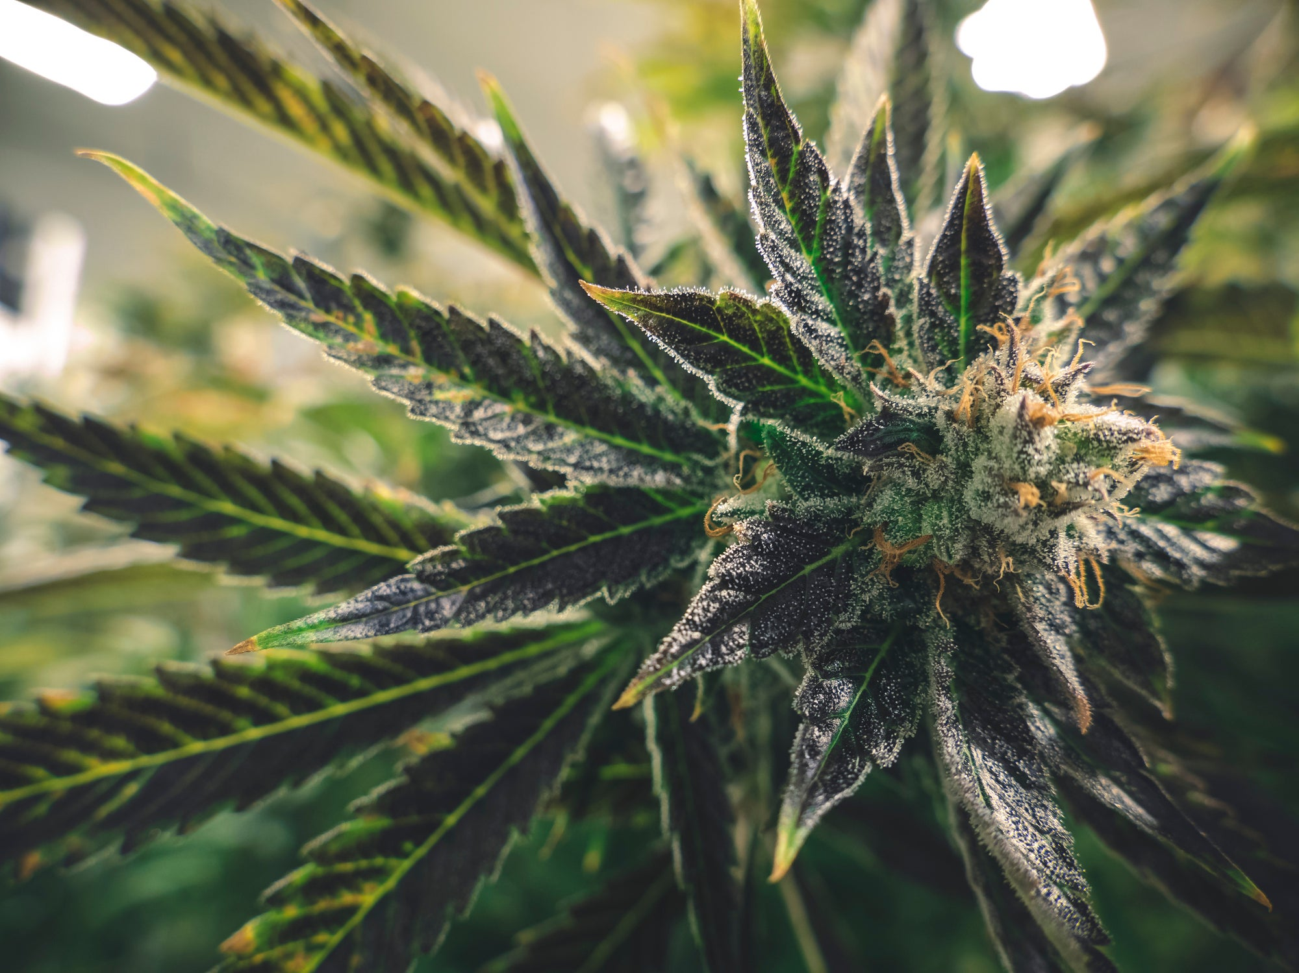
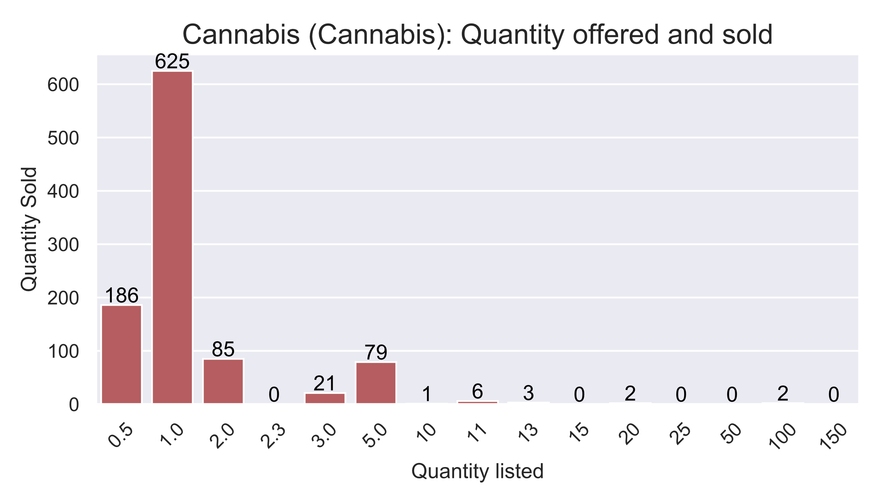
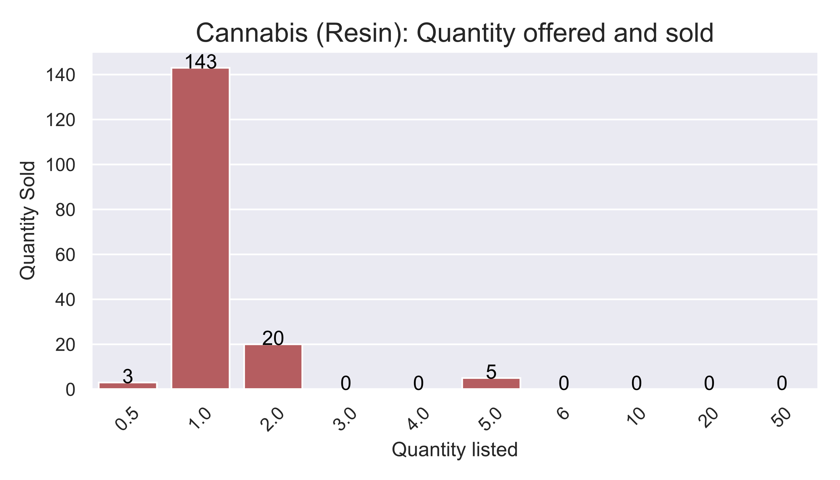
Cannabis
Sales Distribution
Type | Total sales | Total sold (g) | Total sold (USD) | Median quantity (g) | Price (median USD per g)
Herbal | 1,010 | 1,701 | 57,094 | 1.0 | 39.3
Resin | 171 | 210 | 13,398 | 1.0 | 69.8
Largest substance by number of sales
Two (easily identifiable) forms: cannabis and resin
Former cheaper than latter
Lots of small volume sales, however larger volumes frequent
Almost no sales in dataset of synthetic cannabis
Possession of small quantities effectively decriminalized
Global trend away from criminalization
Notes:
I don’t want to spend too much time on cannabis, even though it’s by far the largest substance by number of sales. It’s not particularly dangerous, it’s legal in some countries, and barely illegal here.
We see nearly 2 kilos sold over the course of the scrape, mostly in the herbal form. I’ve not been able to effectively split the stronger and weaker forms of herbal cannabis, so some of the price figures might be a bit inaccurate.
Two things that are interesting here:
We see here clear evidence that it’s being offered (and sometimes sold) in bulk for resale in commercial quantities of up to 150 grams. As I said earlier, these larger listings are a pain to estimate sales for, so the commercial market may be a lot more active than this chart suggests.
The other, very positive thing to mention is what we don’t see in the dataset. I’ve found almost no synthetic cannabis at all. This suggests that a vibrant market for the real thing may have displaced an inferior substitute.

Slide 19
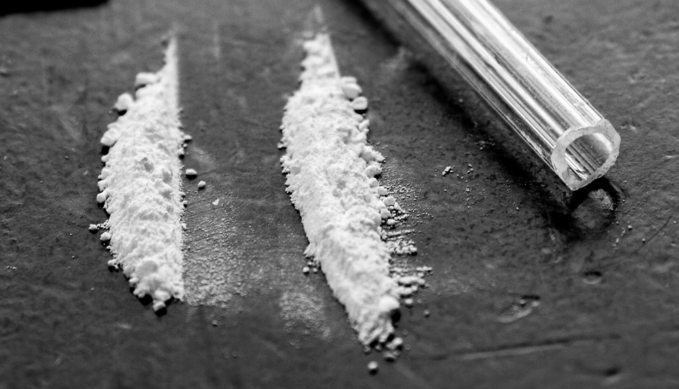
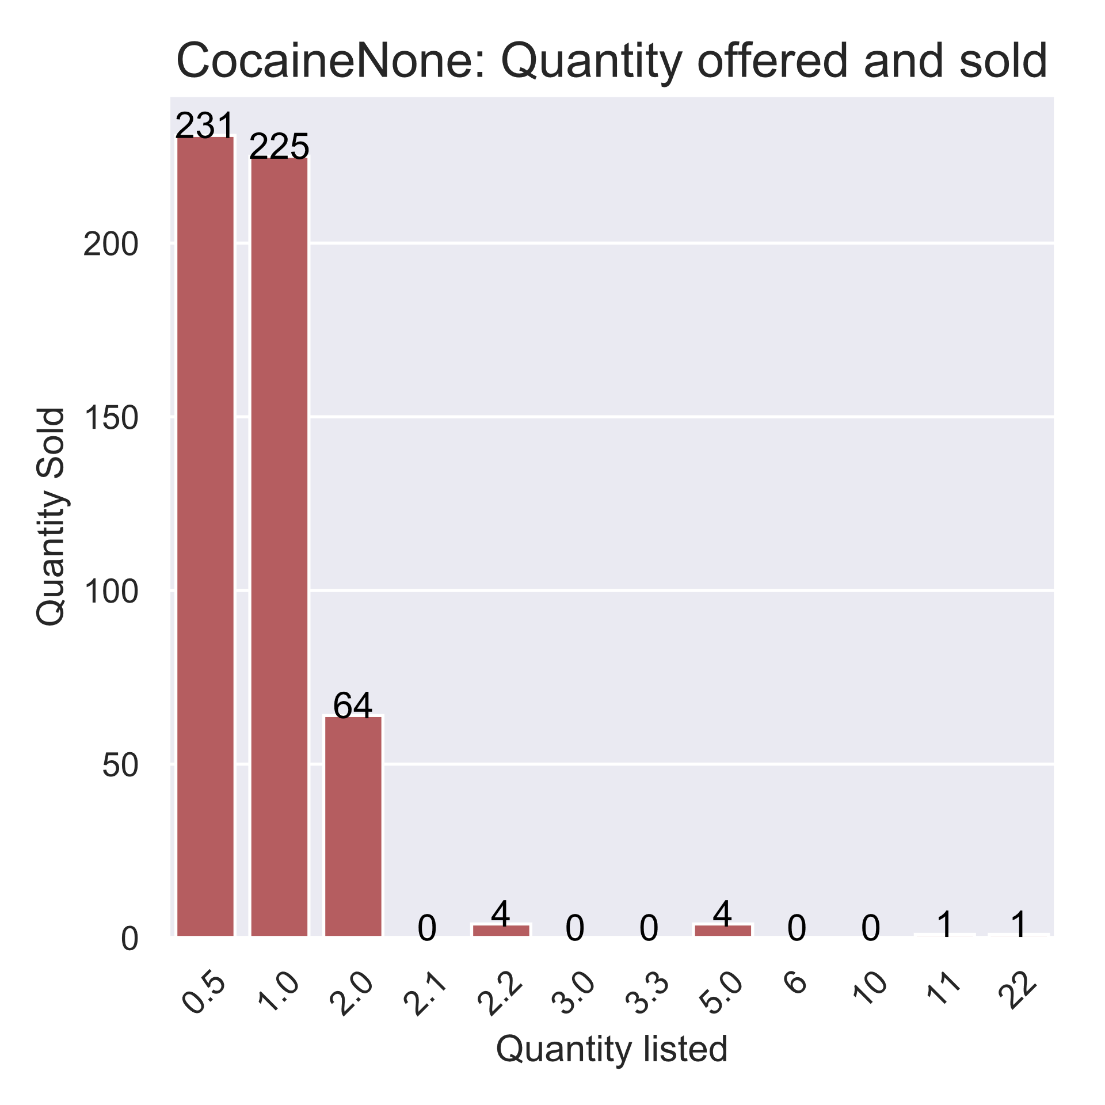
Cocaine
Sales Distribution
Type | Total sales | Total sold (g) | Total sold (USD) | Median quantity (g) | Price (median USD per g)
Powder | 530 | 530 | 95,543 | 1.0 | 184
Largest substance in dataset by USD value and second largest by sales made
Only sold in powder form
Most sales in <=1g quantities, although some bulk buying
Expensive and addictive:
Long term health and psychological issues
Notes:
I was a little surprised to see cocaine feature so prominently. It’s come a long way to Georgia, probably through more profitable markets.
Accordingly, cocaine is one of the most expensive items in the dataset. It’s bought in high frequency and has generated the most revenue. Just over half a kilo of it has been sold through the platform in the last month.
It appears to be only sold in powder form, as opposed to freebased crack, which is good.
We see some listings in the up to 22 gram range, including at least one sale at 11 and 22 grams – this is again presumably for resale. The vast majority of purchases are either one or two gram batches.
From a risk and harm perspective, cocaine is expensive and addictive, and can lead to long term health and psychological issues. It’s typically snorted, but can also be injected, and its likely that in a context with such high prevalence of injecting drug use some users are doing so.
I need to speak to more people in the healthcare profession, but it’s probably not completely unfamiliar in the Georgian context. The quantity of sales being made though suggest there’s a small, but lucrative and active market for the substance. Definitely on the ones to watch list.

Slide 20
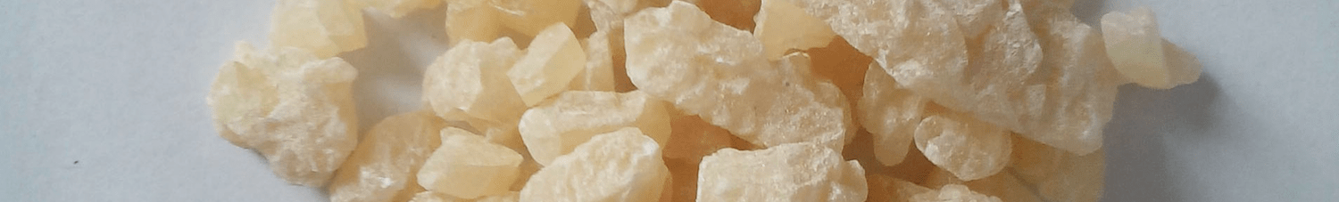
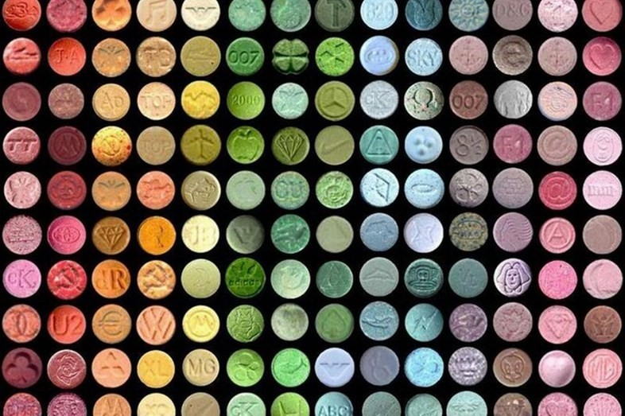
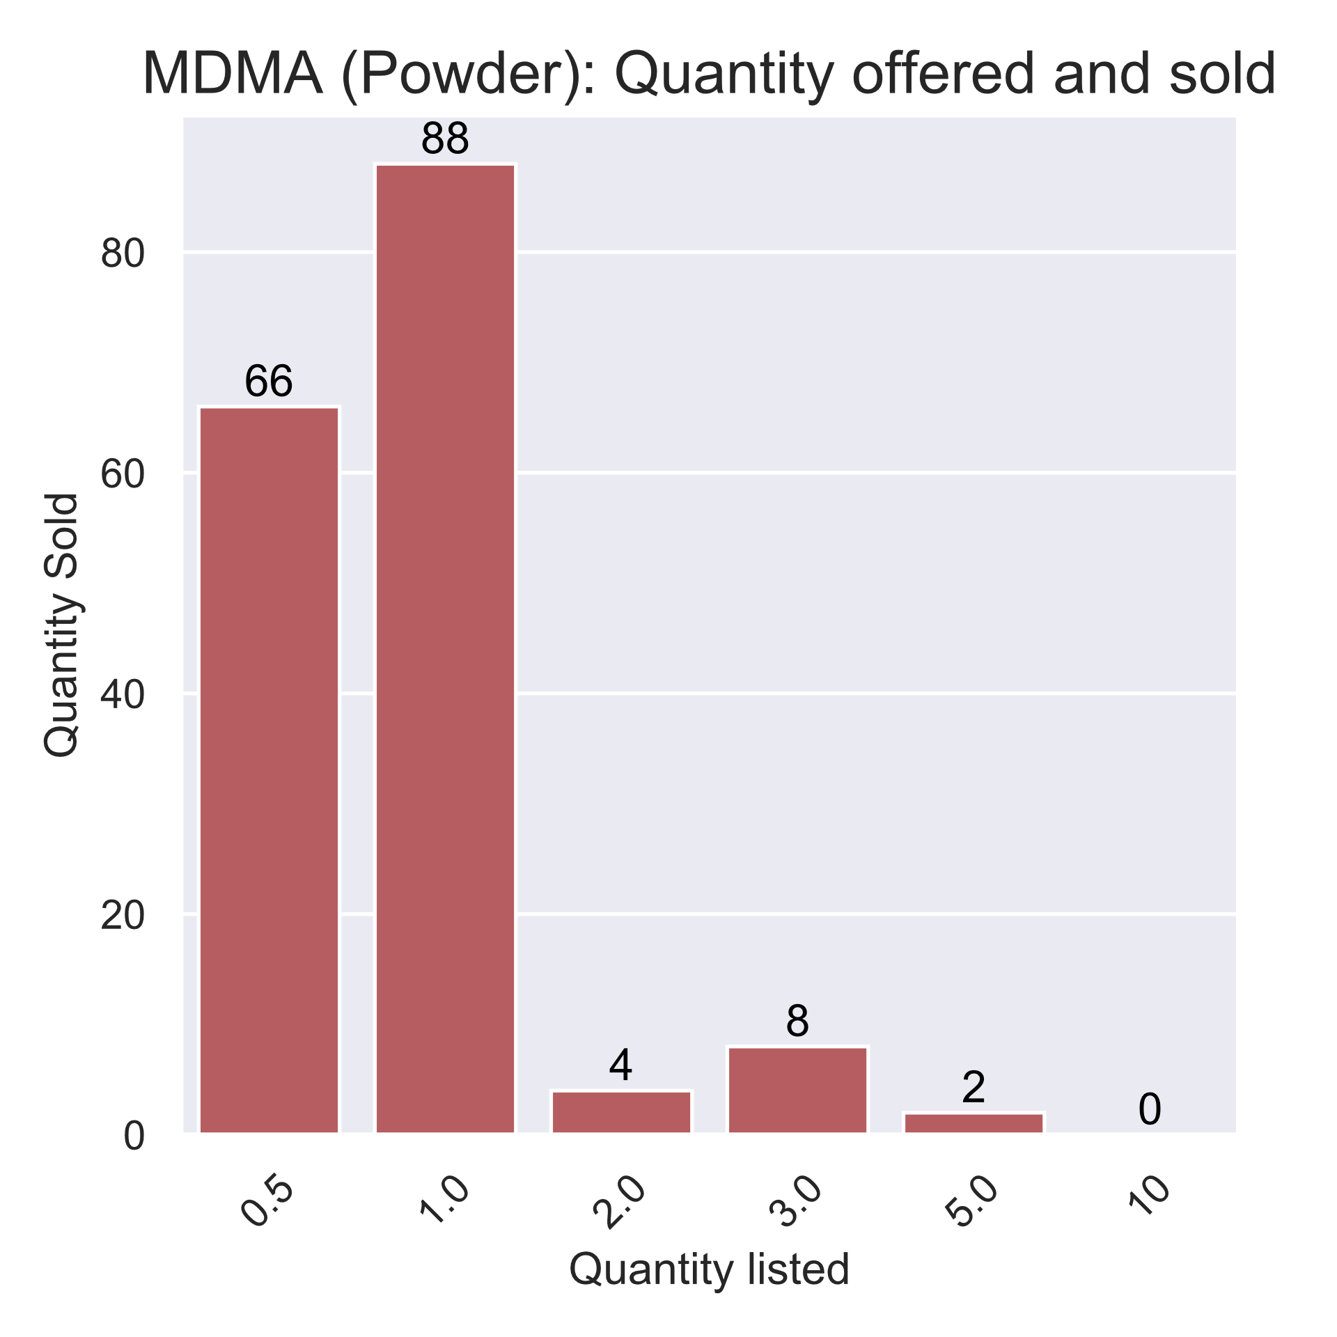
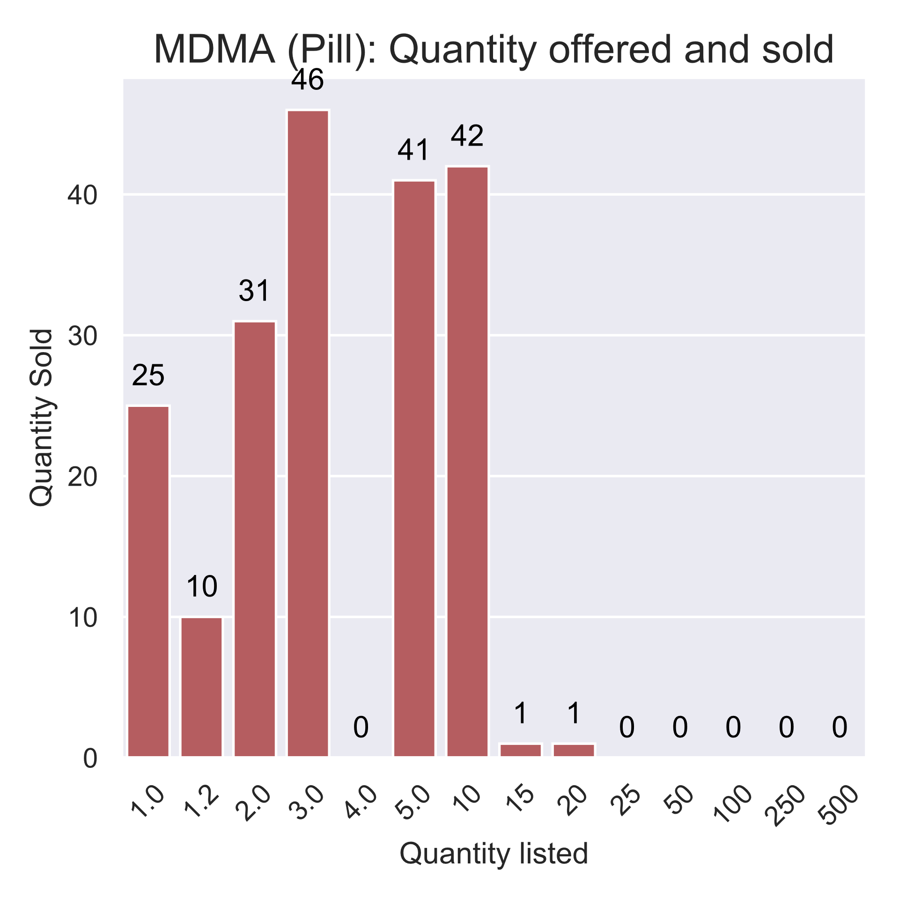
MDMA / Ecstasy
Sales Distribution
Type | Total sales | Total sold | Unit | Total sold (USD) | Median quantity (g) | Price (median USD per g)
Pill | 197 | 897 | Pill | 28,533 | 3.0 | 34
Powder | 168 | 163 | Gram | 16,630 | 1.0 | 106
Second largest category of drug by number of listings
Sold in pill and powder form, pills accounting for more sales
Pills more often sold in bulk, but not in commercial quantities
Listings include unsold (?) listings for up to 500 pills
Risks include adulterants, overdose possible in very large quantities, however most recorded fatalities linked to environmental issues (e.g. dehydration) or interactions with other substances,
Some pills being sold via Matanga are very strong, all exceed a “strong” dose*
Pill Strength
Stat | Mg
min | 223
max | 450
mean | 301
median | 300
* MDMA – PsychonautWiki, retrieved 09/03/2020, https://psychonautwiki.org/wiki/MDMA
Notes:
We saw very large quantities of ecstasy sold – nearly 900 pills across around 200 sales. The distribution chart is really interesting again here: Again, bearing in mind that we can’t necessarily see sales at larger quantities, I think it’s safe to say that this is a substance that is clearly being offered for resale. The largest batch of pills being sold is in a batch of 500, this is a serious commercial quantity, but I think we could consider anything above 10-20 range to be beyond the point of just buying for friends.
As part of my research, I’ve also been looking at how much drugs have been destroyed by the Georgian police – that slide didn’t make the final cut for this talk, but this is interesting to mention here. We actually see nearly twice as many MDMA pills here sold in the last month than we did in police disposal over six months.
In powder form, we see that sales are being made and quantities offered much more at the personal scale. Ten grams is most certainly a commercial quantity of MDMA, five possibly, but most listings are much more in the personal use/buying for friends range.
One of the nice things about this dataset, it that it’s possible to extract strength in certain cases – I’ve put summary stats down the bottom.
From a harm reduction perspective, we’re seeing very high strength pills being sold, which can increase the risk of adverse effects. MDMA has been linked to a number of high-profile deaths, however whilst dangerous in very large quantities, it’s actually one of the safer substances here. It has no link with addiction, and I’ve seen studies place it below alcohol in terms of harm potential.
That said, as I noted, some of the pills being sold are very strong, and users are subject to risks such as environmental factors like dehydration, or the risk of consuming an unintended substance in the belief that it’s MDMA.

Slide 21
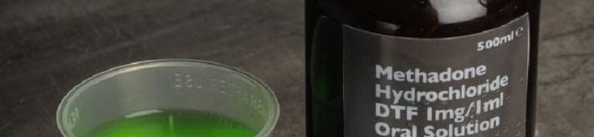
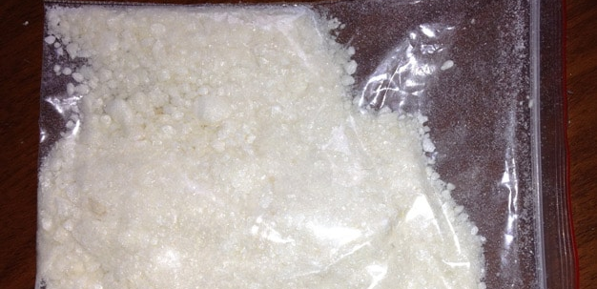
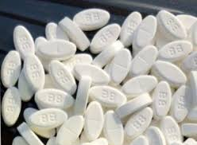
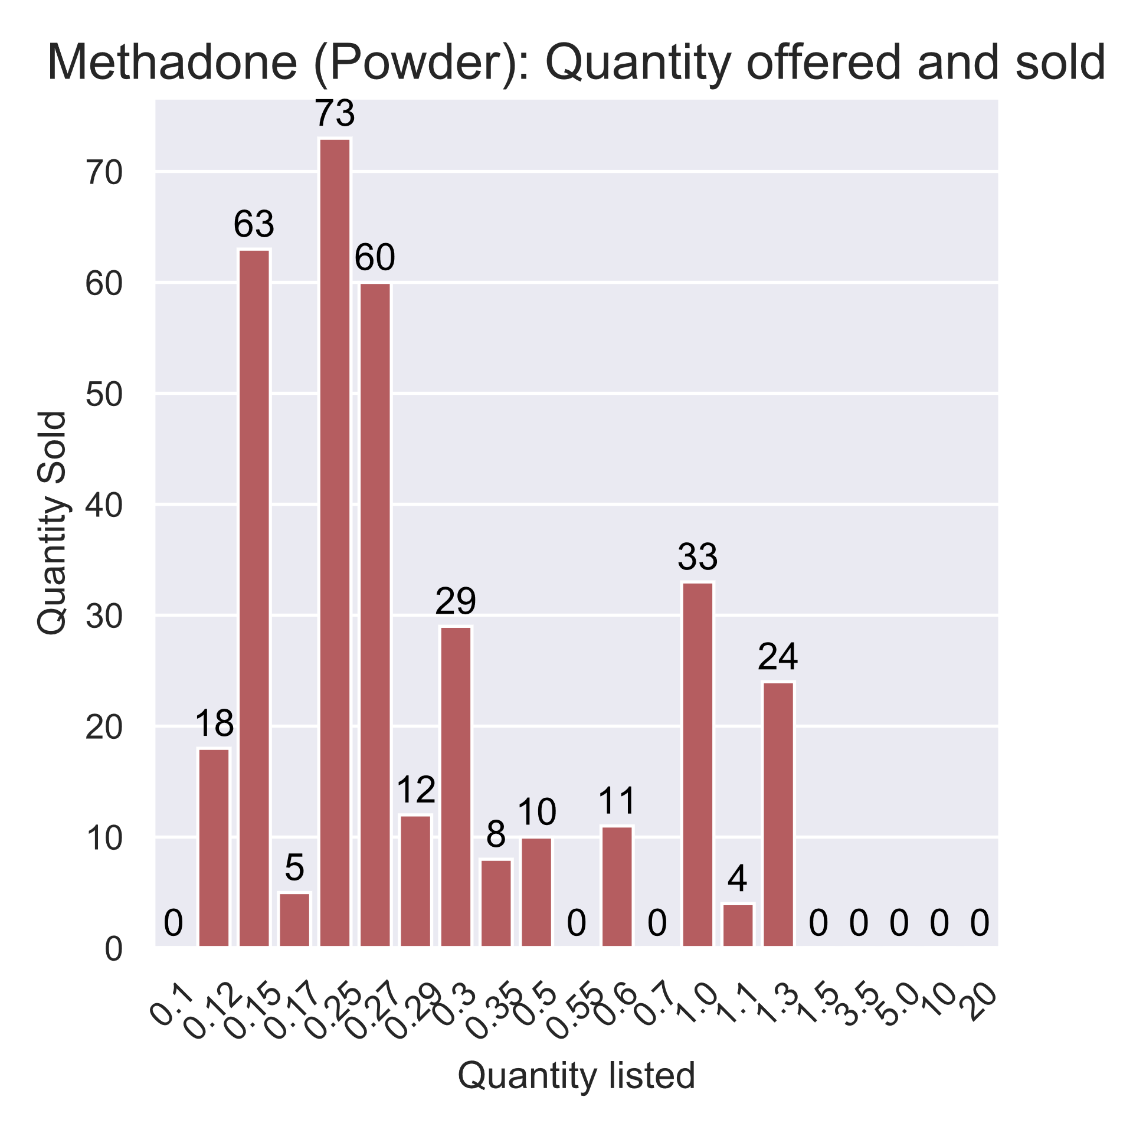
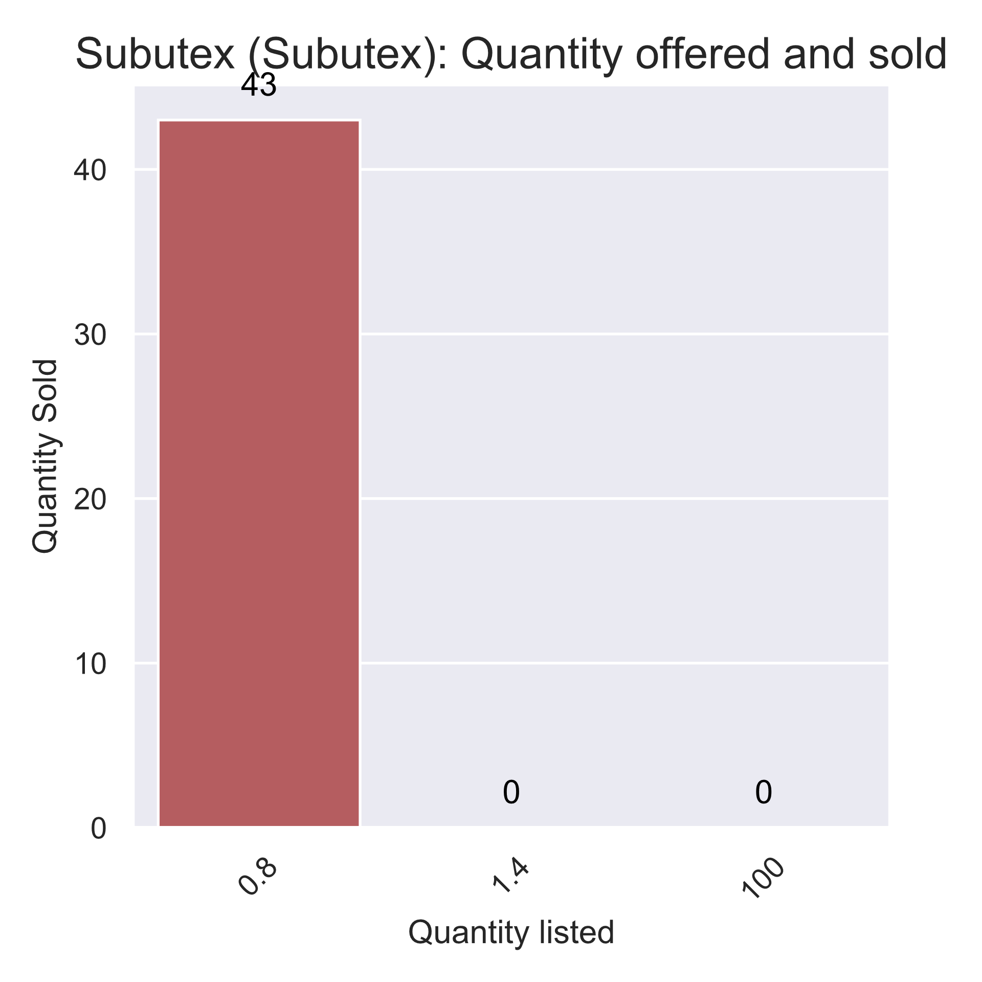
Methadone and Subutex
Substance | Type | Total sales | Unit | Total sold (g) | Total sold (USD) | Median quantity (unit) | Price (median USD per unit) | Price (median normalized USD)
Methadone | Powder | 350 | Gram | 142 | 79,825 | 0.3 | 645 | 187
 | Syrup | 8 | Ml | 32 | 512 | 4.0 | 16 | 64
Subutex | Subutex | 43 | Gram | 34 | 5,418 | 0.8 | 147 | 117
Both methadone syrup and Subutex available through state opiate substitution program
Methadone syrup possibly diverted, low quantities sold,
Subutex features highly in police seizures, surprisingly little in sample
Methadone powder is not, and is presumably intended for injecting
Methadone powder is also very expensive normalized price equivalent to cocaine
Large sums of money for small quantities:
Highly addicted users
Highly potent product
Sales Distribution
Warning labelled
“5g Crystal Methadone ( New batch, incredibly strong, be careful with dosage)” - w1ld1nd1an
Notes:
We now start seeing some much more dangerous substances:
Methadone is available in syrup form through the state-run opiate substitution programme, but what we see here is a much more potent powder variety – presumably for injection.
It’s being sold in very small quantities, sometimes at as little as a tenth of a gram indicating very high strength.
It’s incredibly expensive, particularly when you look at it per gram, but even at USD per median price of a third of a gram, it’s more expensive than cocaine.
It’s addictive, particularly considering that it’s likely being injected.
Someone using this product will require a lot of money, frequently; they will also be at strong risk of accidental overdose.
This is very much the sort of substance that poses a risk of accidental ingestion. It comes in a powder form, like many other drugs – it’s entirely conceivable that an inexperienced user might take this believing it to be another substance, and would put their lives in danger by doing so.
It’s the only substance I’ve seen come with a warning label from a dealer.
Looking at the warning, you’ll note this is a 5-gram listing – very much commercial quantities for a substance where sales begin at an eighth of a gram. Listings go up to 20 grams, which may not seem like a lot, but given the active dose range and the risk of overdose, it’s pretty scary.
---
I’ve also included Subutex here as both substances are linked through the opiate substitution program. I honestly expected to see more, given Georgia’s history with the substance. It appears to be listed almost exclusively in single pill batches or as 100s pills, presumably for resale.

Slide 22
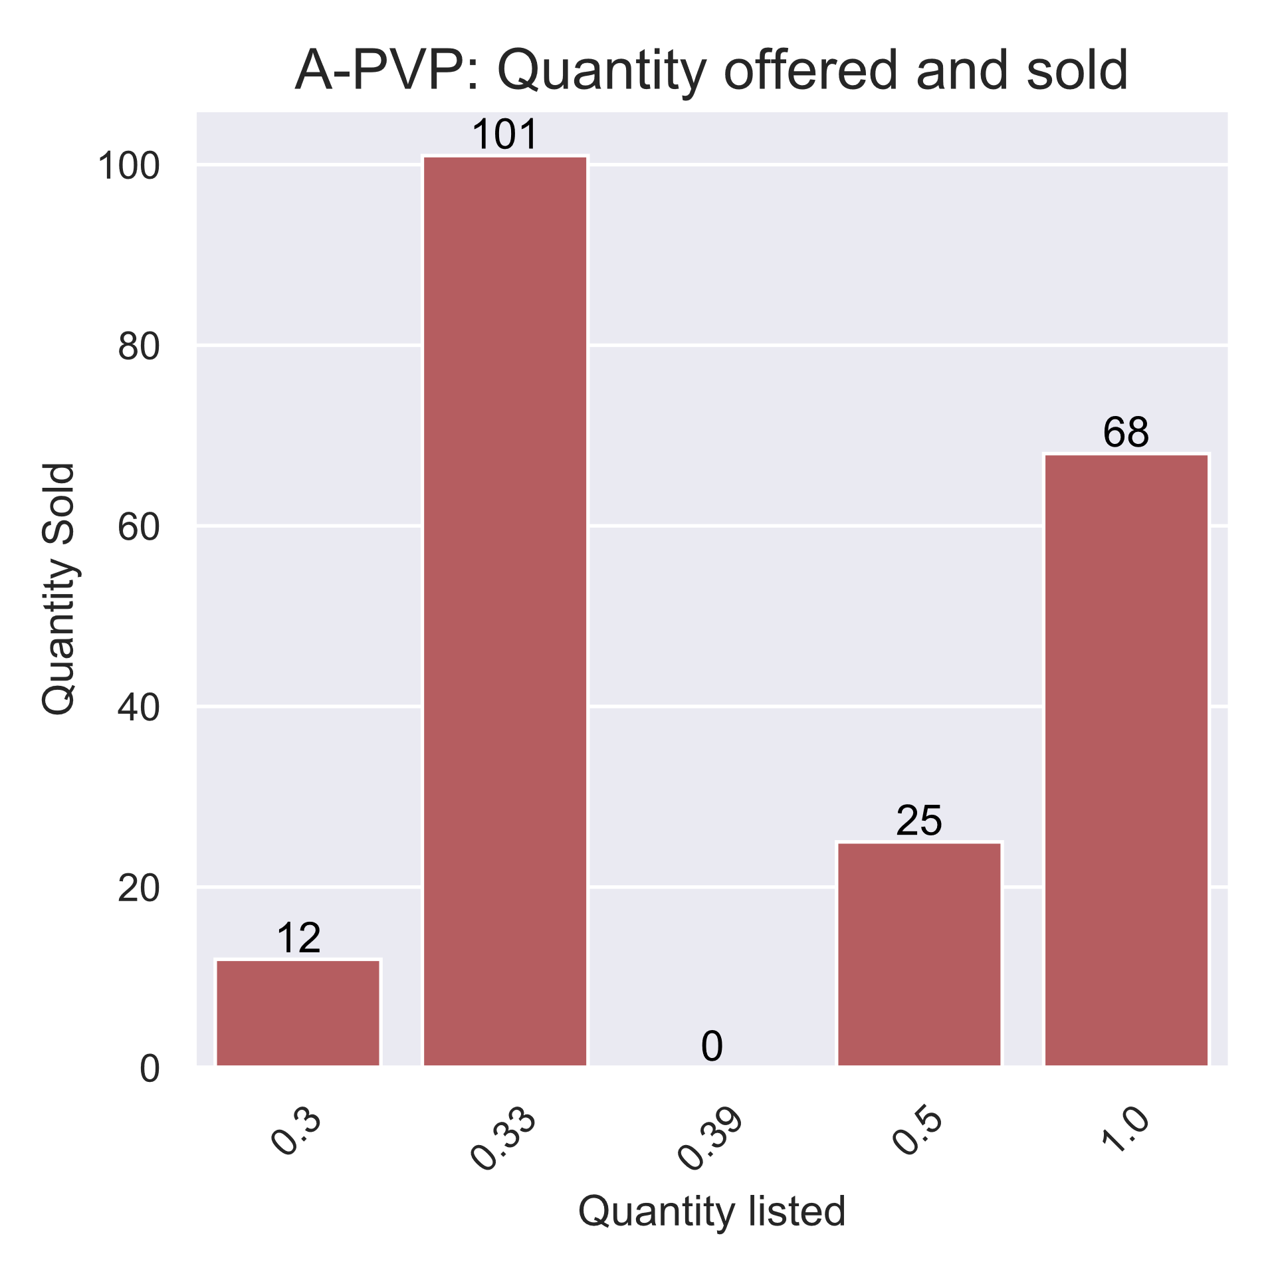
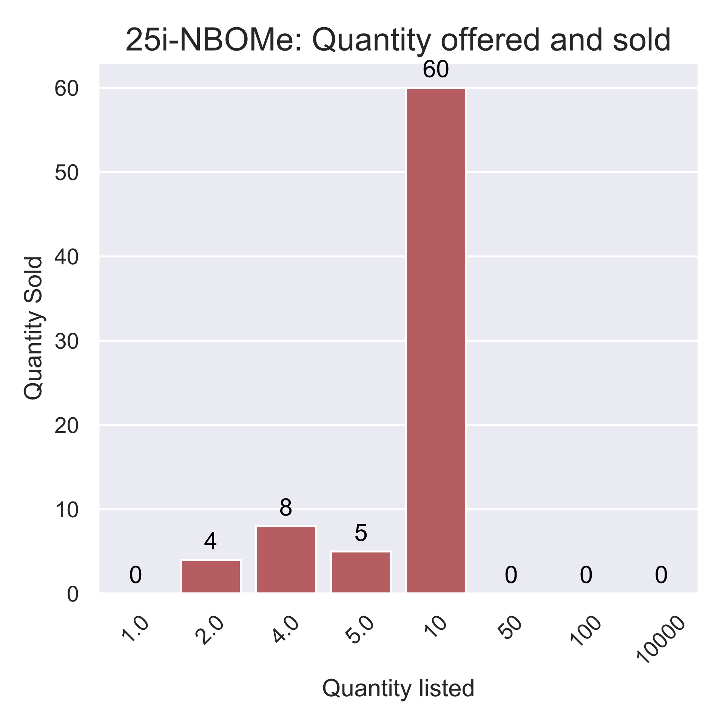
Alpha-PVP and 25i-NBOME
Type | Total sales | Total sold (g) | Total sold (USD) | Median quantity (g) | Price (median USD per g)
A-PVP | 206 | 117 | 16,804 | 0.5 | 159
Type | Total sales | Strength | Total sold (g) | Total sold (USD) | Median quantity (g) | Price (median USD per g)
25i-NBOMe | 77 | 2.5mg | 665 | 5,960 | 10.0 | 9
Notes:
Finally we move on the more esoteric substances
We’ve also high sales volumes for Alpha PVP, which some in the audience may have heard of referred to as Flakka or Bath Salks:
We know very little about this substance as it has a limited history of human use. It’s a powerful stimulant that can be smoked, snorted or injected, and has been linked with psychotic episodes and deaths. It’s potentially being used as an alternative to other stimulants, such as amphetamine, and has strong abuse potential.
It does not appear to being listed in quantities sufficient for resale.
Finally, we see 25i-NBOMe, it didn’t appear in the largest sales group, but I flag this for a couple of reasons:
All the listings that specify a dosage note a 2.5mg dose. This is significant because this is well in excess of a safe dose. Recorded fatalities from this substance start at 2mg.
I’ve spoken to other researchers about the presence of this substance on the market, and I’m informed users are aware of the strength and are practicing dose-sharing to minimize risk, but I find this substance very scary.
As I mentioned before, the substance is visibly indistinguishable from LSD. It has a bitter taste, which experienced users may be able to use to differentiate the two substances, but I still think there’s a very serious risk of accidental overdose from this substance.
The other reason I flag this is that if you take a look at the chart on the right, it is being sold in very, very, very high volume. Someone, somewhere is trying to offload 10,000 blotters of this substance, equivalent to around 40,000 normal doses.
Even accounting for the fact that we see a lot of listings and sales at resale quantities, this substance is also incredibly cheap.
This also seems to be mainly being bought for resale in smaller quantities, with the largest purchase batch size being at the ten blotter point.

Slide 23
Conclusions

Slide 24
Conclusions
Key findings
Policy recommendations
Very diverse, more than 13 different substances
High prevalence of New Psychoactive Substances, sometimes unidentifiable
A lot of cannabis, almost no synthetic cannabis
Matanga is a niche platform, probably with wealthy, educated users – or possibly resellers,
Nonetheless, there is a lot of trade, and total GEL volume exceeds 1m in a month
Very high strength produce
Promote health sector preparedness
Support harm reduction messaging
Notes:
We’ve seen then that there are a wide variety of substances being traded online in Georgia, and in the case of the site examined, most of the more frequently traded substances relate to a very different drug culture than public policy in Georgia has dealt with in the past.
We see a lot of different substances in varying quantities. Alongside more traditional drugs, we also see large quantities of New Psychoactive Substances – which are poorly understood and potentially far more dangerous than the drugs they resemble.
We see an awful lot of cannabis, but despite the presence of a lot of other New Psychoactive Substances, we see almost no synthetic cannabis.
The site is likely a niche part of the Georgian drug market: it requires language skills and a degree of technical sophistication to operate. Some of the substances traded on there are also very expensive by the standards of a typical Georgian salary.
Nonetheless, within a single month we’ve seen high volumes of trading – with around 1 million lari changing hands.
Many of the substances listed are being offered in very high quantities and at very high strengths.
---------------
As a Policy Analyst I’m obliged to now try and make some sort of sense of this from a policy lens. It’s early days and I want to get a better understanding of how the health system manages drug harms before diving in too hard on the policy front, so I’m going to keep things short and topline here.
I’ve been encouraged to keep my recommendations tightly focused on my very fresh data, so my thoughts on sentencing and policing may have to wait for the time being.
From the data, two things strike me immediately.
Health care preparedness
This research shows a very wide range of substances being used, each with a unique risk and harm profile.
Healthcare professionals need to be fully equipped to deal with the acute and chronic consequences of a much wider variety of substances.
Both first responders and family doctors need to be able to identify, manage and treat the symptoms of forms of drug use that are not linked to opiate injection,
Awareness raising and harm reduction
This research shows high-strength doses of a number of substances in circulation. Prevention based messaging, such as “No to drugs” dominates public communications around drug use.
This sort of messaging does not help users apply potentially life-saving harm reduction strategies: such as “do half a pill first” or “25i-NBOMe” should be taken in quarter blotter doses.
Whilst it may not be politically feasible to promote these forms of messaging publicly, the government should be supportive of organizations that to, to the extent of providing funding and facilitating their work.

Slide 25
Any questions?

Slide 26
Injecting drug use in Georgia
Rank | Country | Adults (%) | Total
1 | Seychelles | 3.27 | 2,144
2 | Georgia | 2.24 | 52,500
3 | Puerto Rico | 1.5 | Not given
4 | Russian Federation | 1.3 | 1,314,620
5 | Mauritius | 1.30 | 11,677
6 | Republic of Moldova | 1.23 | 31,562
7 | Ukraine | 1.09 | 341,500
8 | Kazakhstan | 1.09 | 127,800
9 | Azerbaijan | 1.08 | 71,283
10 | Malaysia | 0.94 | 170,000
Information provided for 109 out of 230 territories surveyed.
Missing
Large, important countries e.g. Germany,
Other FSU: Turkmenistan, Uzbekistan
Conflict Zones: Iraq, Syria, Yemen, Somalia
Small countries
Methodological differences
United Nations Office on Drugs, and Crime. World drug report 2019. United Nations Publications, 2019.
Notes:
At one point, Georgia had the highest per-capita level of injecting drug use in the world, with around 4.2% percent of the adult population [4.19% (0.48,7.90) | 115,000 (13,000, 217,000)] estimated to be injecting drugs.
This figure has, been halved over the last two decades, and in 2016 was estimated to be closer to 2.2% [2.24% (2.13%, 2.39%) | 52,500 (50,000 –56,000)]

Slide 27
Drugs and public policy in Georgia
Enforcement
Enforcement based
Punitive sentencing
Long prison terms for trace amounts
Abstinence-based Awareness
Treatment
Monitoring
20 opiate substitution clinics
8,897 patients
7,065 methadone
1,832 buprenorphine (Subutex)
9 “narcological” clinics
8 in Tbilisi
1,473 patients (2017)
New drug monitoring agency being established this year
Based on the EU ECMDDA model
Under the MIA
Notes:
Whichever way one looks at it, the fact remains that for injected drugs at least, Georgia has a serious problem. This issue has been recognized for a long time, with 2004 figures putting the injecting drug use estimates at twice where they stand today.
To date, the government’s policy response has centered around two key approaches:
Prevention: including punitive sentencing for possession of controlled substances, and anti-drugs campaigns
Treatment: including opiate substitution and abstinence
Enforcement-based measures take up significant proportion of police time. Something that immediately struck me when I ran this chart was that recorded drug-related crime accounts for over twice that of transport-related crime, which includes traffic offences.
When we look at the proportion of “solved” cases between the two, i.e. where someone has been successfully prosecuted, we can see a startling difference in the way these crimes appear to be prioritized.

Slide 28
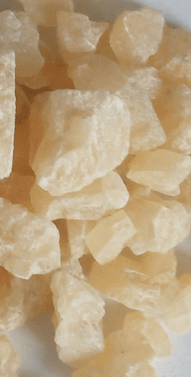
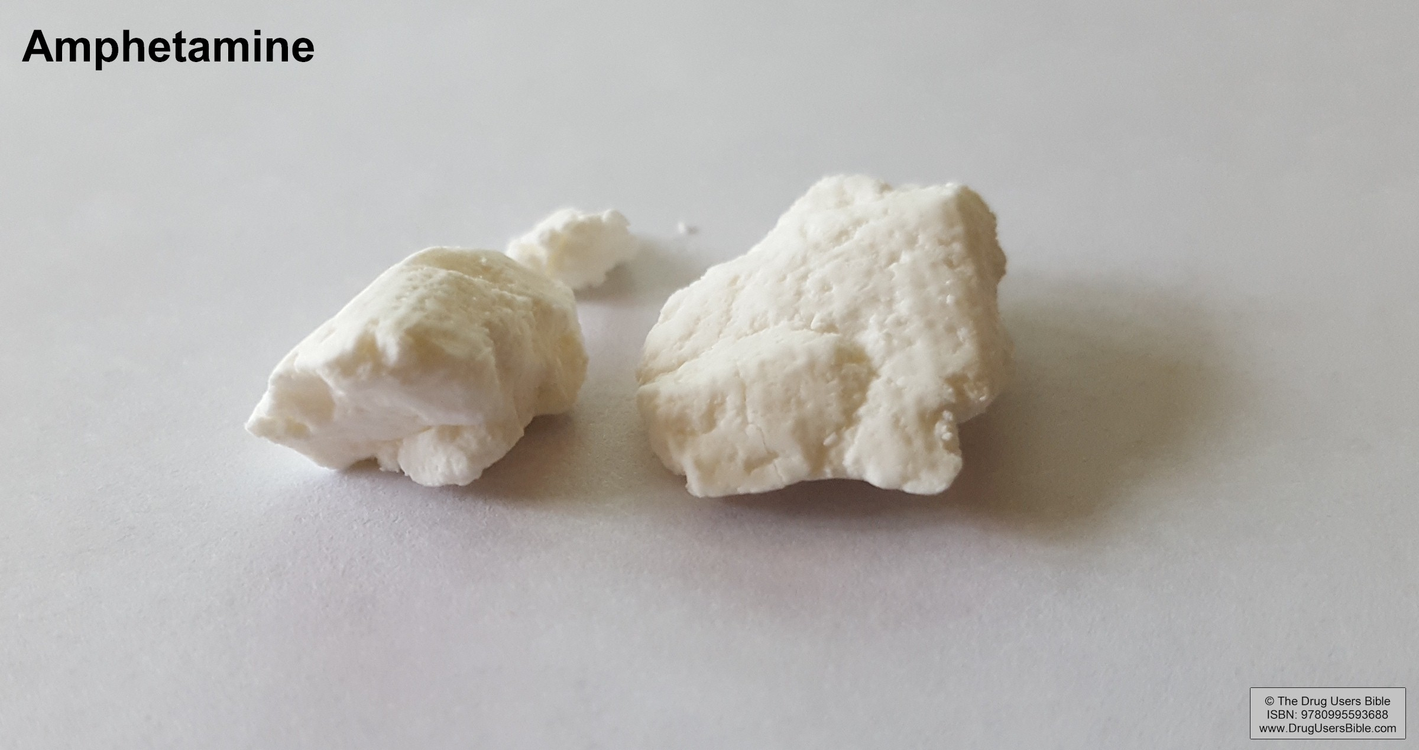
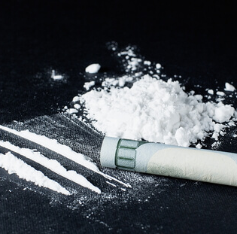

New Old Drugs
Ecstasy/MDMA
Amphetamine
Cocaine
LSD
Notes:
One of the main things we see from the substances appearing in the previous slide is the presence of drugs that are well established within western markets, but perhaps less familiar to policy makers and health practitioners who are used to a drug market predominately based on opiates and opiate substitutes.
Other substances that appear are more exotic.

Slide 29
How do we know what we know about drugs?
Health Statistics, Surveys, Police Records
Notes:
So, how do we know what we know about drugs?
Traditionally, researchers have three main sources of information to look at when studying drug-taking behavior:
We have health records, which I’ve briefly touched on,
Surveys,
And police statistics
I’ll briefly look at the latter two now, before introducing new approaches which have opened up in recent years.

Slide 30
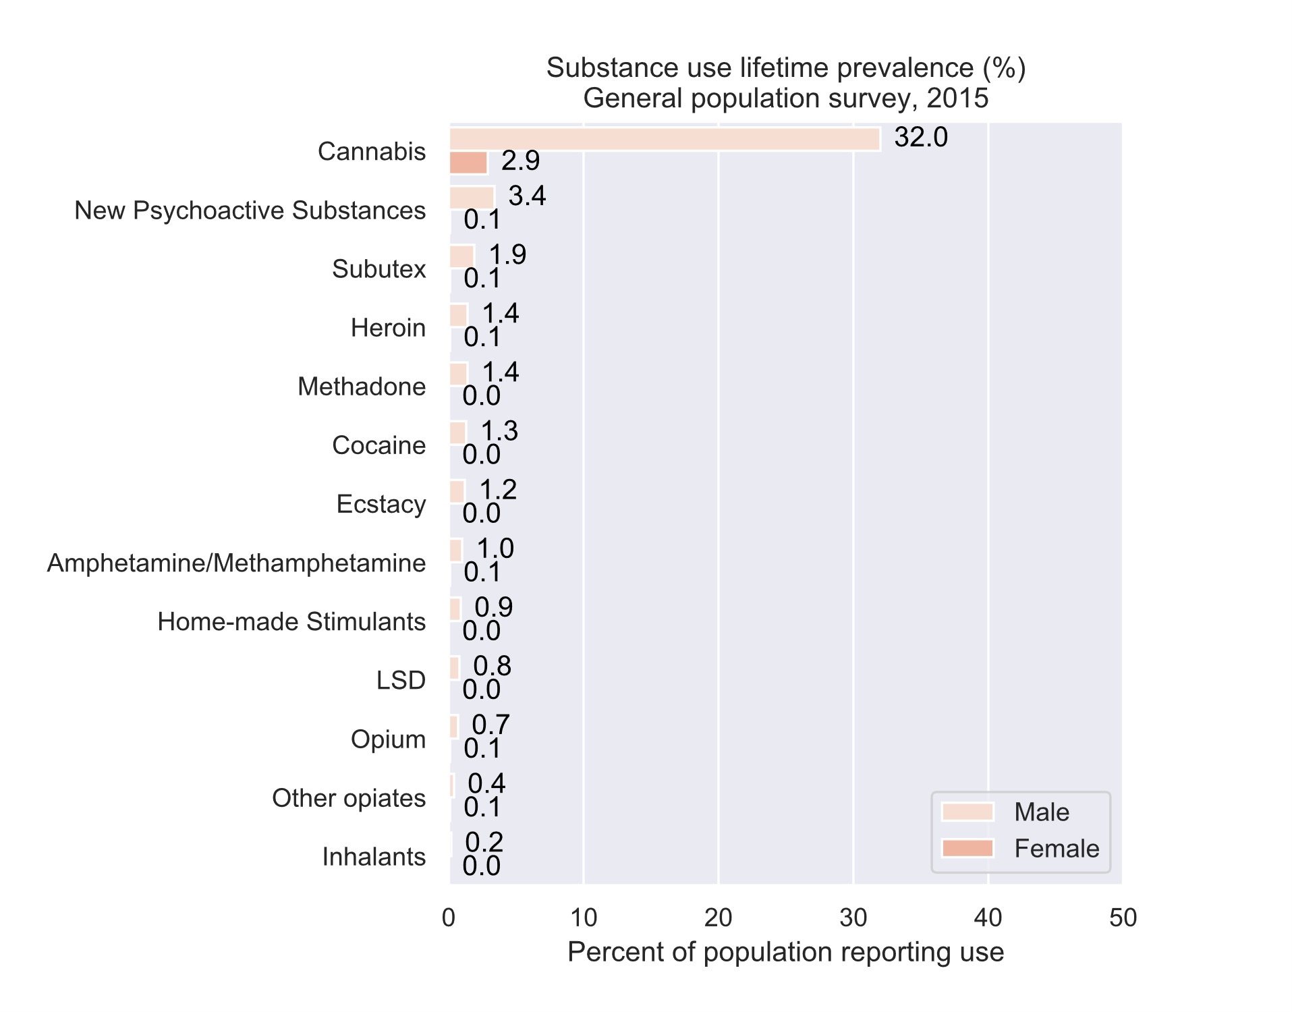
Surveys
General Population Survey, 2015
Findings
A lot of cannabis
Very few women use drugs
Opiate usage around population estimate for injecting drug users
However
Drug surveys are difficult and may suffer from under reporting
Little detail
Old
Kirtadze, Otiashvili, Tabatadze. (2016). National Survey on Substance Use in the General Population in Georgia, 2015
Kirtadze, Otiashvili, Tabatadze, Vardanashvili, Sturua, Zabransky, Anthony. (2018). Republic of Georgia estimates for prevalence of drug use: Randomized response techniques suggest under-estimation. Drug and Alcohol Dependence, 187, 300–304.
Notes:
The primary source of survey information on drug use in Georgia is the General Population Survey, conducted in 2015. It provides us with a great introduction to drug use in Georgia, but has a number of limitations from a research perspective.
Looking at the results of the survey:
We see large levels of use of cannabis, around a third of the male population.
Virtually no use of any drug, by any woman, ever,
And 3.4% of the male population have used category of substances called “New Psychoactive Substances”, which we’ll come to later.
However, whilst this serves as a good starting point for looking at drug use in Georgia, it does have a number of crucial limitations.
People, and women potentially more so underreport drug use. The authors of the survey have actually done a great follow-up piece estimating the extent of underreporting for the 2015 survey. It’s quite substantial.
We don’t get much detail on substances used. They’re often grouped together, and based on a finite list.
The survey is also now half a decade old.

Slide 31
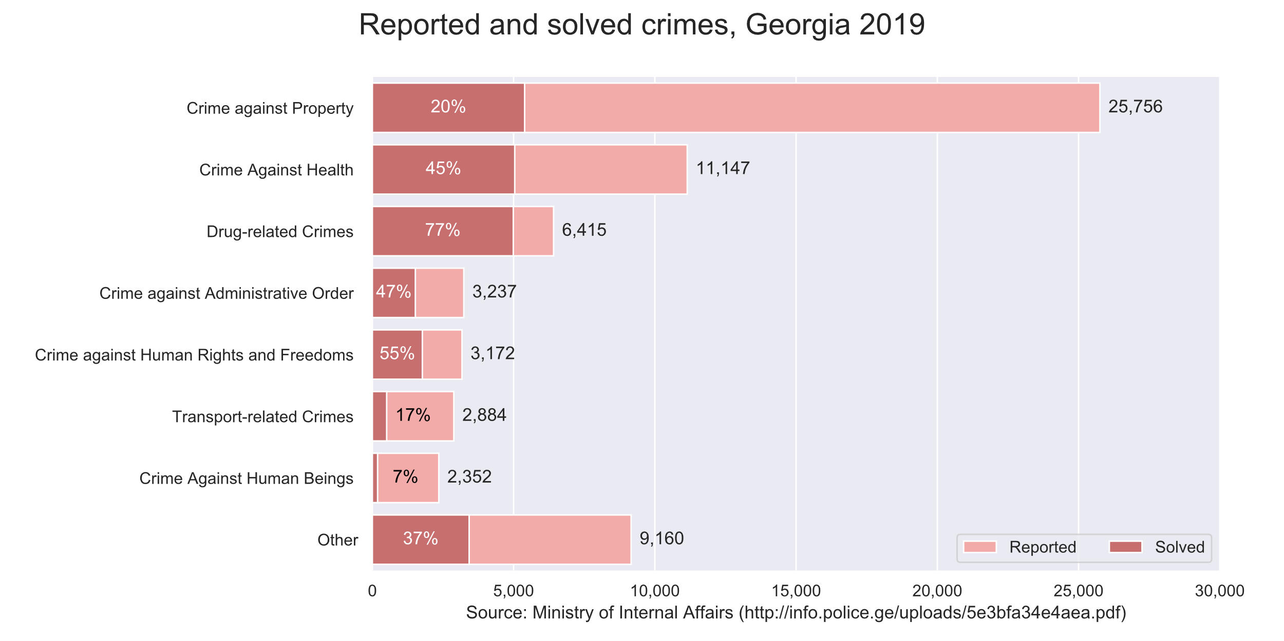
Police Records
Crime Reporting
Notes:
Drug related crime is clearly a priority for the Georgian police force, it is the third largest category of crime in the country, and accounts for the highest proportion of crime solved.
I invite you to compare the figures for drug crime with those for traffic-related crimes, which include traffic violations.
With this level of activity, we can assume that we can get a better picture of drug use from law enforcement sources.

Slide 32
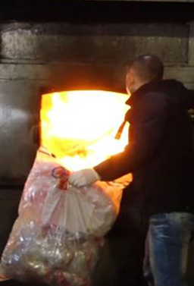
Police Records
In the last six months police seizures reported destroyed on agenda.ge, over:
300 kg cannabis
5.2 kg heroin
13,000 pills pharmaceuticals including pregabalin, tramadol and codeine
5,200 pills of Subutex
550 and 58.3 gr of methadone
1,100 pills amphetamine
450 pills MDMA
1.3 kg cocaine
Other reports make reference to LSD, Alpha-PVP, and other unspecified “New Psychoactive Substances”
Source: Agenda.ge
Notes:
For the time being, we can look at what they’re reporting in the press. Every three months, the Georgian police are obliged to destroy substances confiscated in their operations, and they report what they destroy on Agenda.ge. I’ve listed rough figures for the last six months on the slide.
The most significant category of substance destroyed in the last six months is, by a long way, cannabis. We also see large quantities of the opiates, opiate substitutes, and pharmaceuticals – mostly painkillers. We also see MDMA, amphetamine and cocaine.
If we trawl around other reports, however, we come across other substances, including Alpha-PVP, LSD and unspecified “New Psychoactive Substances”, amongst others.
We get an interesting snapshot of what’s in circulation here, but it’s not systematic.

Slide 33

Cleaning and processing
Dropping records outside of full-content date range and non-substance listings
String cleaning (e.g. “1г” -> 1) and transliteration
BTC – USD conversion for consistent pricing
Rules based system for identifying substance from description
Secondary check and manual input for uncategorized records
Notes:
Once the data has been collected, I’ve undertaken a bit of a clean-up.
My main database has patchy records outside of the main date range of the study, so I drop them. I also drop non-substance listings, for example people sometimes offer work as a courier.
I normalize prices in USD based on bitcoin value on the day of transaction.
And then I employ a rules-based system for labelling records from their descriptions. This is a real pain, you have no idea how many different ways you can say “Does anyone want to buy some cannabis”?
The system I’ve devised isn’t perfect, so I then do a post-clean to manually label anything that was missed.

Slide 34
Sales estimation
We have “ready” in our data, which tells us how many packages are distributed and awaiting collection
Daily sales per listing can be estimated from the:
Sum of:
The change in this number between t and t-1
Multiplied by a Boolean vector where t < t-1
Sales from the previous day are brought forward to ensure between day sales aren’t missed
Simulated sales for one listing: “e.g. 1 gram of cannabis, 30 USD, for sale in Batumi, by mrweedman”
d | t | Xt | Xt-1 | xt – xt-1 | Xt < Xt-1 | (xt – xt-1) x (xt < xt-1) | Σ
1 | 1 | 3 | NA | 0 | 0 | 0 | 3
1 | 2 | 2 | 3 | -1 | 1 | -1
1 | 3 | 9 | 2 | 7 | 0 | 0
1 | 4 | 7 | 9 | -2 | 1 | -2
2 | 1 | 7 | NA | 0 | 0 | 0 | 5
2 | 2 | 6 | 7 | -1 | 1 | -1
2 | 3 | 2 | 6 | -4 | 1 | -4
Notes:
One advantage this dataset has over other sources of information about drug use in Georgia, is that we are able to make estimates of the quantity of product being sold.
I mentioned that “in stock” column earlier. We can use changes in this value to estimate the number of sales – as the in-stock number decreases, we can assume it’s because an item is being sold.
I’m more of a programmer than a mathematician, and I’m assuming most of the audience are neither, so I’ll attempt to keep the explanation of the process brief.
For each listing, for each day, I count the differences between each record and the last, to see how many items have been sold. I only do so if the “in stock” value in question is less than the previous record. This happens often as vendors “restock” in new locations. It’s not really possible to check exactly how large a restock was between two different scrapes, so it’s likely that this approach underestimates here.
I’ve also noticed that the larger listings are almost never shown as “in stock”. This makes sense, as there’s a lot of risk involved in leaving thousands of dollars of drugs lying around somewhere. My assumption is that for the larger listings, vendor and buyer will be linked up through the site, then communicate outside of the site to establish protocols for exchange.
Accordingly, the findings I’m about to present should be taken to be minimum values, and will likely somewhat overrepresent small trades.

Slide 35
Policy Recommendations
Ensure monitoring is targeted at strengthening policy
Promote health sector preparedness
Support harm reduction messaging
Undertake sentencing review
Improve opiate substitution programme
Learn from other countries
Notes:
Monitoring
A new drug monitoring agency is being established this year under the Ministry of Internal Affairs, this is a welcome development insofar as it will hopefully provide much needed information on drug use to the policy community
The focus of the agency should be targeted at improving drug policy and reducing harm, rather than as a mechanism to support enforcement,
This could include frequent and transparent reporting of drug seizures and incidents related to drug harm, including substances involved, in a machine-readable format.. Please.
Health care preparedness
This research shows a very wide range of substances being used, each with a unique risk and harm profile.
Healthcare professionals need to be fully equipped to deal with the acute and chronic consequences of a much wider variety of substances.
Both first responders and family doctors need to be able to identify, manage and treat the symptoms of forms of drug use that are not linked to opiate injection,
Awareness raising and harm reduction
This research shows high-strength doses of a number of substances in circulation. Prevention based messaging, such as “No to drugs” dominates public communications around drug use.
This sort of messaging does not help users apply potentially life-saving harm reduction strategies: such as “do half a pill first” or “25i-NBOMe” should be taken in quarter blotter doses.
Whilst it may not be politically feasible to promote these forms of messaging publicly, the government should be supportive of organizations that to, to the extent of providing funding and facilitating their work.
Opiate substitution
Other studies have shown that injecting drug use is on the rise, and this research demonstrates the presence of dangerously strong opiates in the form of methadone powder on the Georgian market.
Georgia has a long-standing opiate substation programme, which is intended to manage its injecting drug using population.
Taken together, these facts suggest that the opiate substation programme is failing many users.
The government should urgently take action to strengthen and improve the programme, in coordination with experts on injecting drug use.
Sentencing Review
Georgian law treats almost all drugs in almost all quantities as highly illegal and punishable by long prison terms.
This research shows that substances being sold in Georgia are highly diverse, with dramatically varying levels of risk potential.
By treating all substances equally and punitively, the government sends a message that all substances are equally dangerous, but this is not the case.
People are taking drugs, despite these laws, and young people encountering drugs encounter no guidance as to relative harm.
On discovering one substance is not so bad, they may incorrectly assume this finding applies to all substances.
The government needs to understand that as drug use is likely to continue despite severe penalties, it has the power to use sentencing to affect the drugs which are taken.
This research shows that in a colourful drug market, with large quantities of New Psychoactive Substances, we see a lot of cannabis and almost no synthetic cannabis.
It is not a huge logical jump to conclude that lower penalties for cannabis possession may be linked to a fall in demand for alternatives.
The government should undertake a sentencing review for narcotic substances, and reevaluate penalties on an evidence-based, harm-based system, where less harmful substances receive lower penalties.
Lower sentences overall would also lower barriers to accessing healthcare by drug users, meaning assistance can be reached when needed, potentially saving lives
Learning from other countries
More radically, and admittedly less closely tied to the findings I’ve just presented, the government may choose to examine learning from other countries.
Portugal has had stunning success in reducing drug use and harms through an approach that decriminalizes possession of small quantities of drugs and diverts drug users from the prison system to counselling and medical support.
Other countries are increasingly fully legalizing cannabis.
Strict prohibition has clearly not prevented a vibrant drug market from existing

